Slide 1
AI Resume Analysis and Recruitment System
GUIDED BY,
Mrs. M. Thanga Aruna
Assistant Professor , ME, (PhD)
Saila Vishnu G (24BCS058)
Sakthi Yokesh S (24BCS059)

Slide 2
Introduction
AI Resume Analysis and Recruitment System—a cloud platform that reimagines talent matching.
The tech stack combines Sentence Transformers for semantic understanding, spaCy for intelligent resume parsing, and Gemini API for contextual feedback. ChromaDB powers vector search, letting recruiters find candidates with natural language queries. ATS scoring analyzes formatting, keywords, and structure—not just keyword counting.
Mock interviews use Retrieval-Augmented Generation to create personalized scenarios pulling role-relevant questions and candidate context for real-time evaluation.
Two portals: students get coaching; recruiters get smarter screening and analytics.

Slide 3
Problem Statement
Recruiters spend excessive time on manual screening. Evaluating hundreds of resumes manually consumes resources without scaling. Good candidates often get overlooked in the process.
Students lack structured guidance. No resume templates, minimal feedback on application quality, and no opportunity for interview practice. They navigate the job search without direction.
Resume quality goes unmeasured. Students submit weak applications without knowing it. No system evaluates resume strength, identifies skill gaps, or provides concrete improvement suggestions before they apply.

Slide 4
Objectives
To develop a resume analysis tool that provides detailed feedback and actionable improvement suggestions.
To develop mock interview practice with performance tracking and real-time evaluation.
To develop automated resume screening with intelligent AI-powered candidate ranking.
To develop faster hiring cycles through semantic matching and improved candidate-job fit.

Slide 5
Expected Outcomes
Students will identify resume weaknesses and improve application quality before submission.
Students will gain confidence and interview readiness through structured mock interview practice.
Recruiters will reduce manual screening time and focus on high-quality candidates.
Hiring teams will complete screening-to-shortlist cycles faster with better candidate matches.

Slide 6
Dataset Details
Models (No Custom Training):
Sentence Transformers – Pre-trained on semantic similarity tasks.
spaCy NLP – Pre-trained English language models.
Gemini API & Grok API – Pre-built, maintained by providers.
User-Generated Data (During Operation):
Student resumes (PDF/DOCX format).
Job descriptions from recruiters.
Mock interview responses and performance data.
User feedback for continuous improvement.

Slide 7
Working Environment
IDE:
• VS Code – Frontend, backend, and AI/ML development.
Version Control:
• Git & GitHub – Code management and collaboration.
Local Development:
• Node.js & npm – Frontend and backend dependencies.
• Python virtual environment – AI/ML services.
• MongoDB Atlas – Database testing and development.
Cloud Services:
• Cloudinary – Image and file storage.
• Postman – API testing and documentation.
Deployment:
• Vercel – Frontend deployment.
• Render – Backend and API deployment.

Slide 8
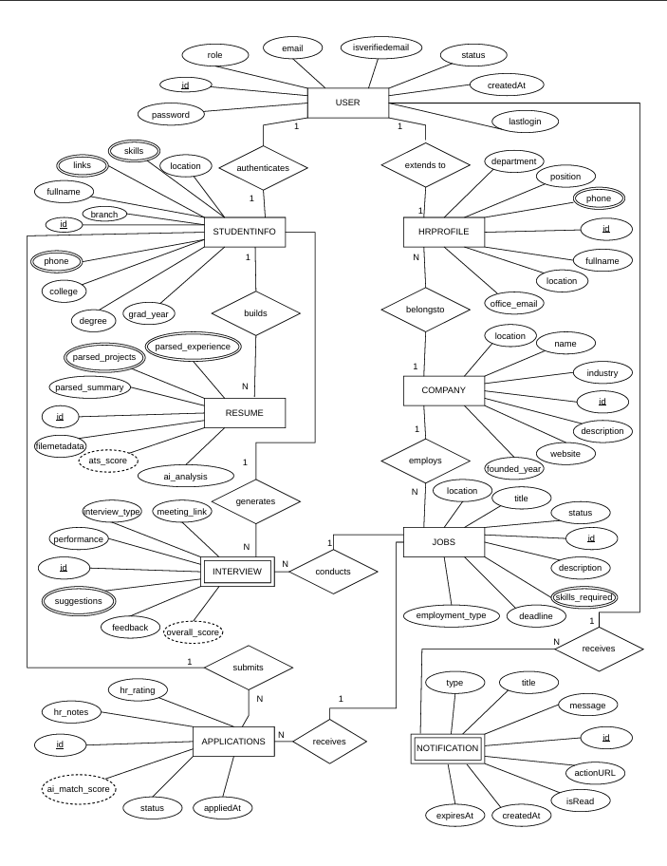
ER Diagram
Hyperlink : ER Diagram

Slide 9
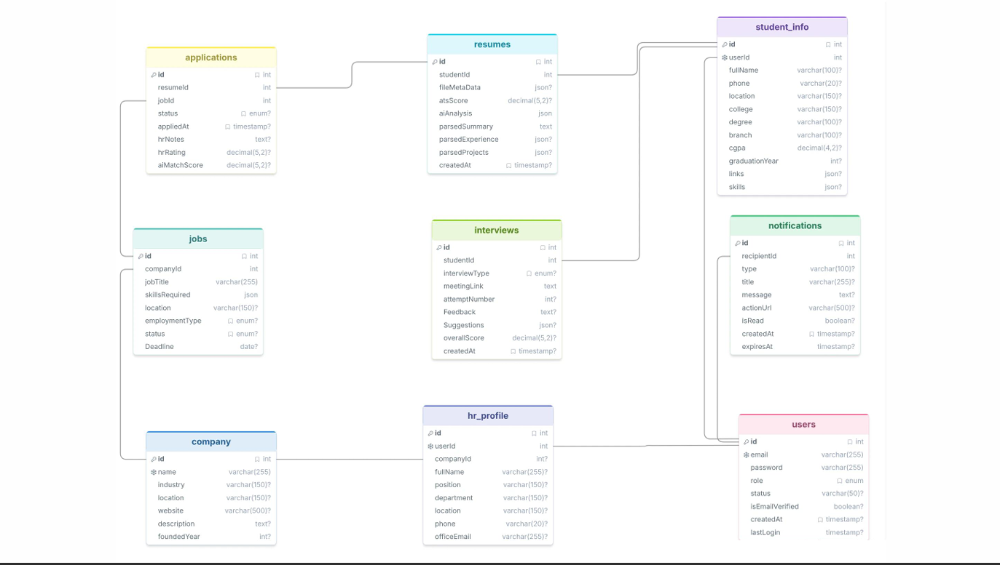
Database Schema Diagram
Hyperlink : Schema Diagram

Slide 10
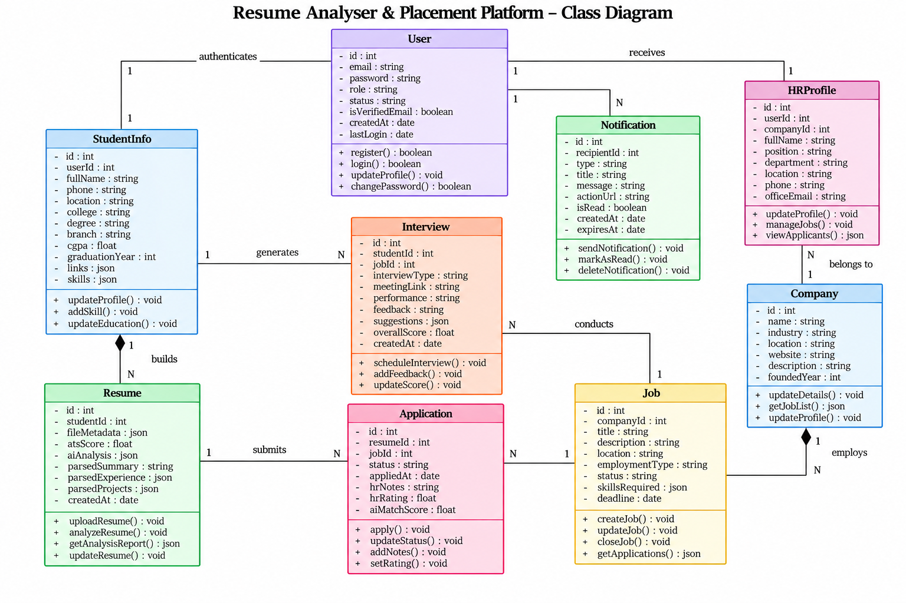
Class Diagram

Slide 11
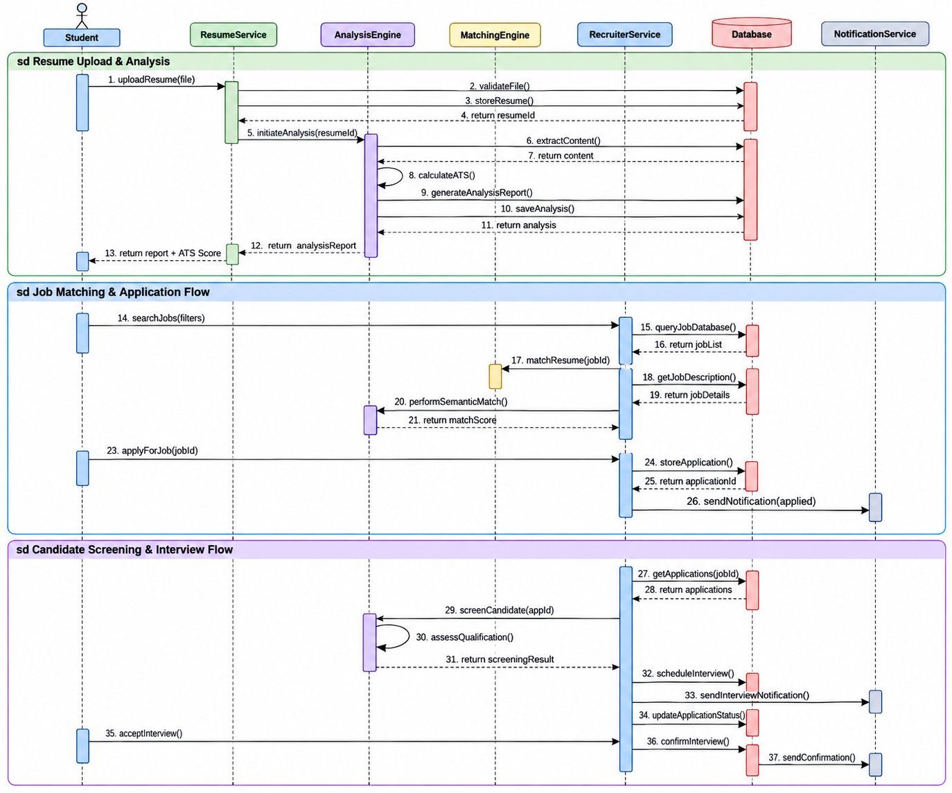
Sequence Diagram

Slide 12
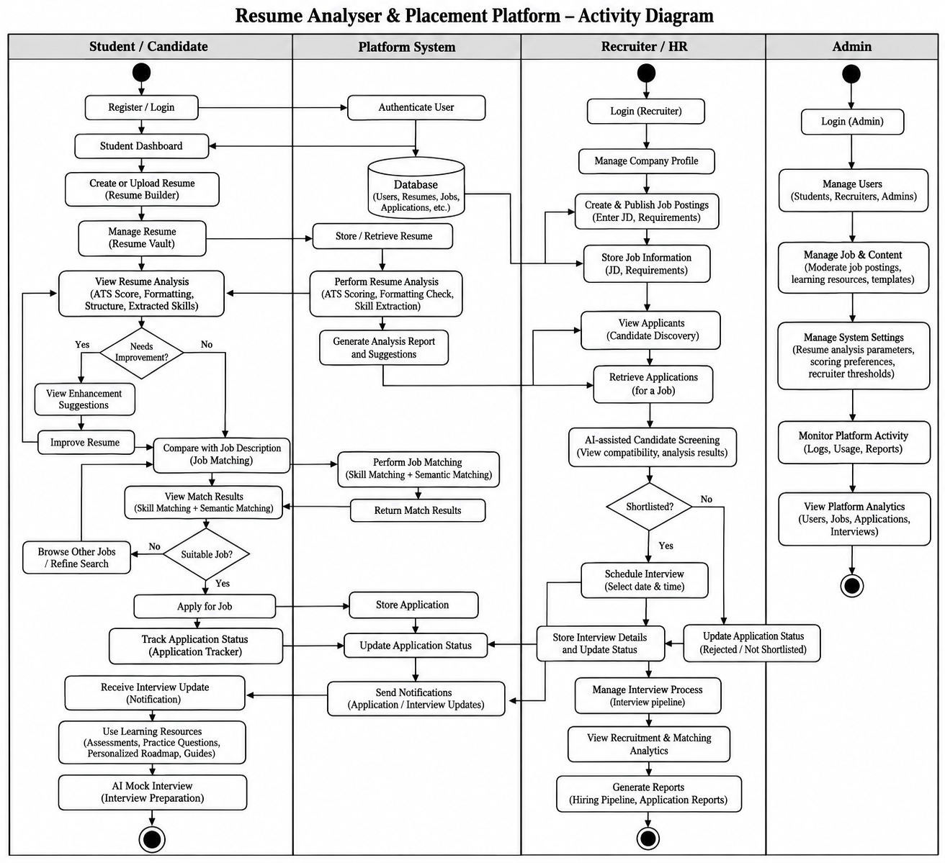
Activity Diagram

Slide 13
Module Descriptions
UI Module – React UI for both student and recruiter portals. Node.js/Express API, authentication, and request routing.
AI/ML Module – Python FastAPI,
Sentence Transformers, spaCy NLP, Gemini / Grok API, semantic matching, resume parsing.
Cloud Services Module – Cloud storage for file/image, Vercel for frontend hosting, Render for backend deployment and Mongo DB for database.

Slide 14
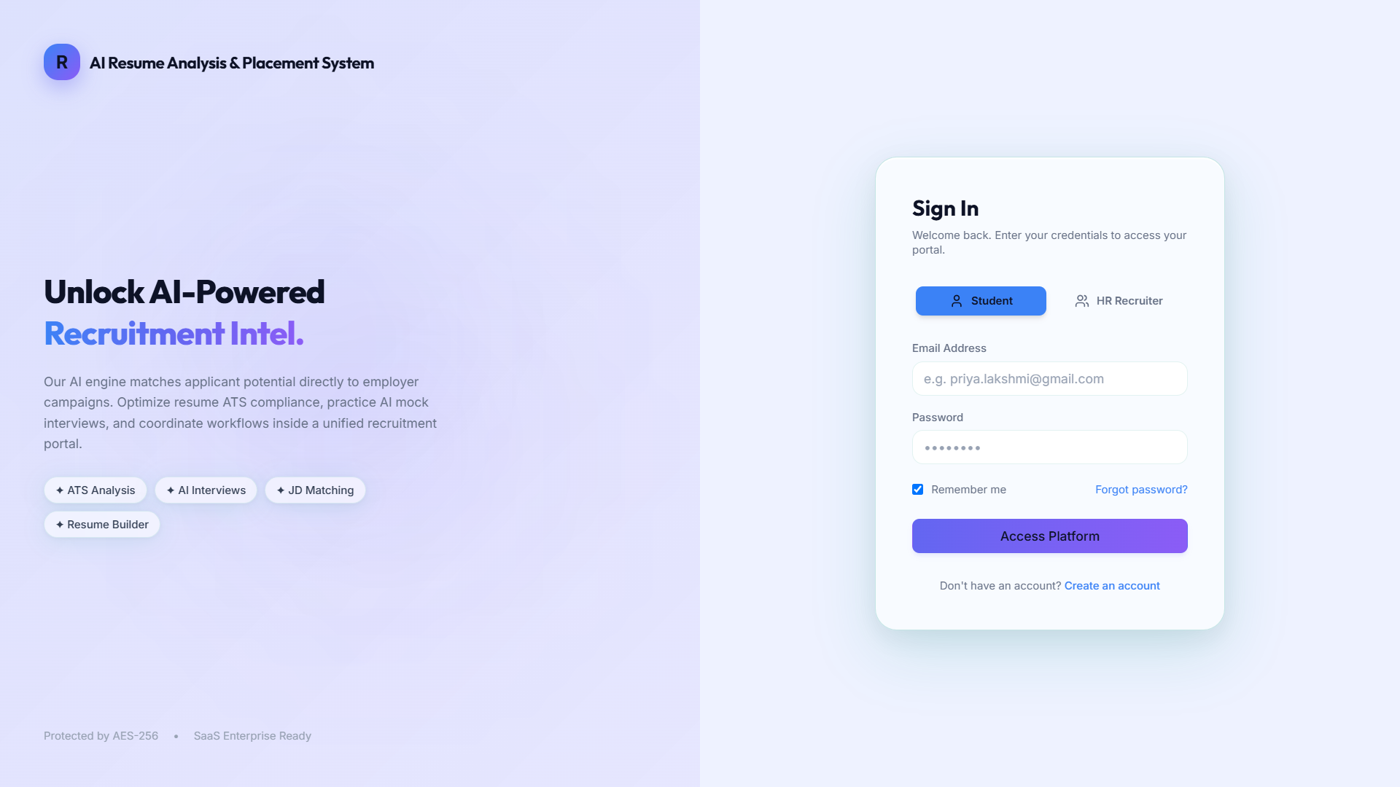
UI Screenshots
Fig 1.1: Login Page

Slide 15
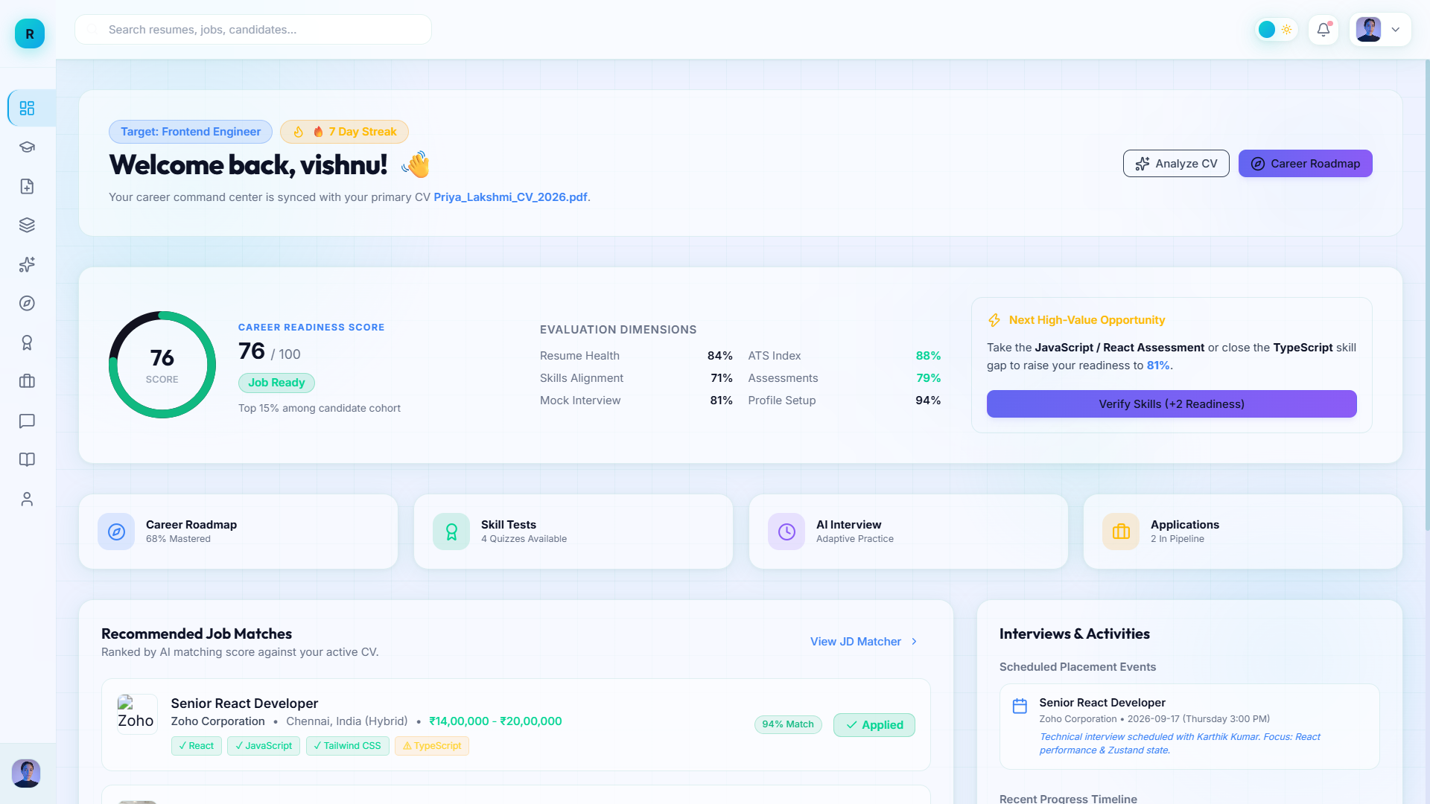
Fig 1.2: Dashboard Page

Slide 16
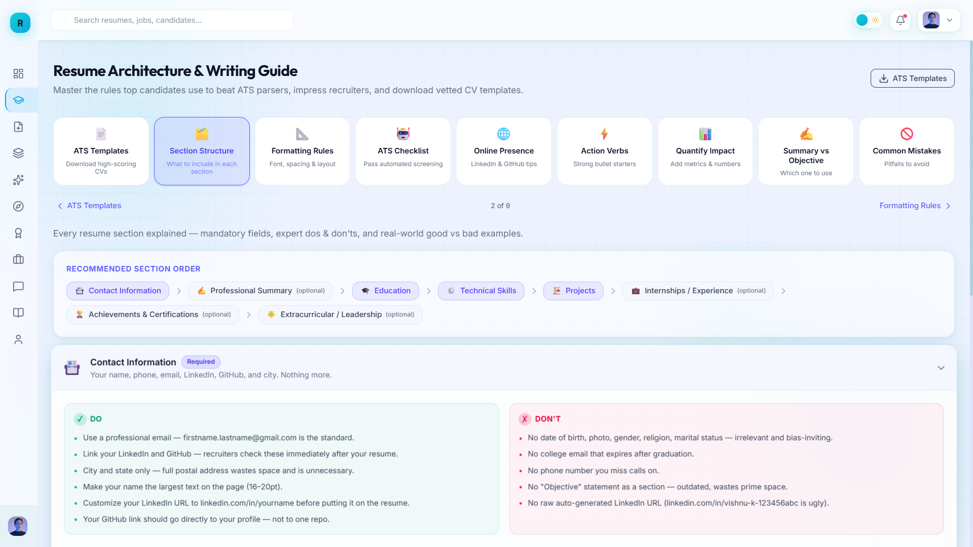
Fig 1.3: Resume Guide Page

Slide 17
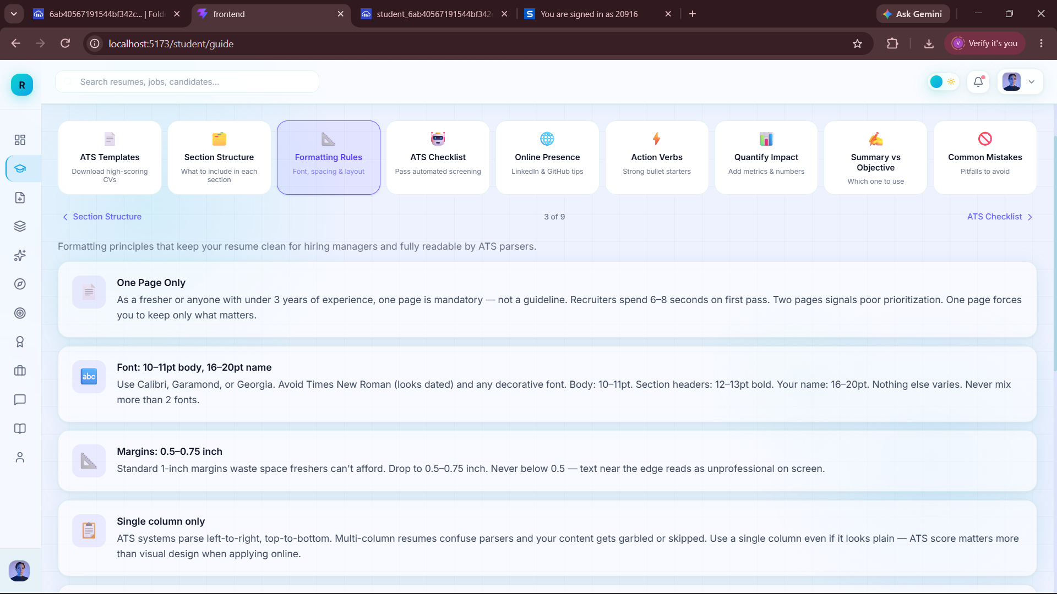
Fig 1.3: Resume Guide Page

Slide 18
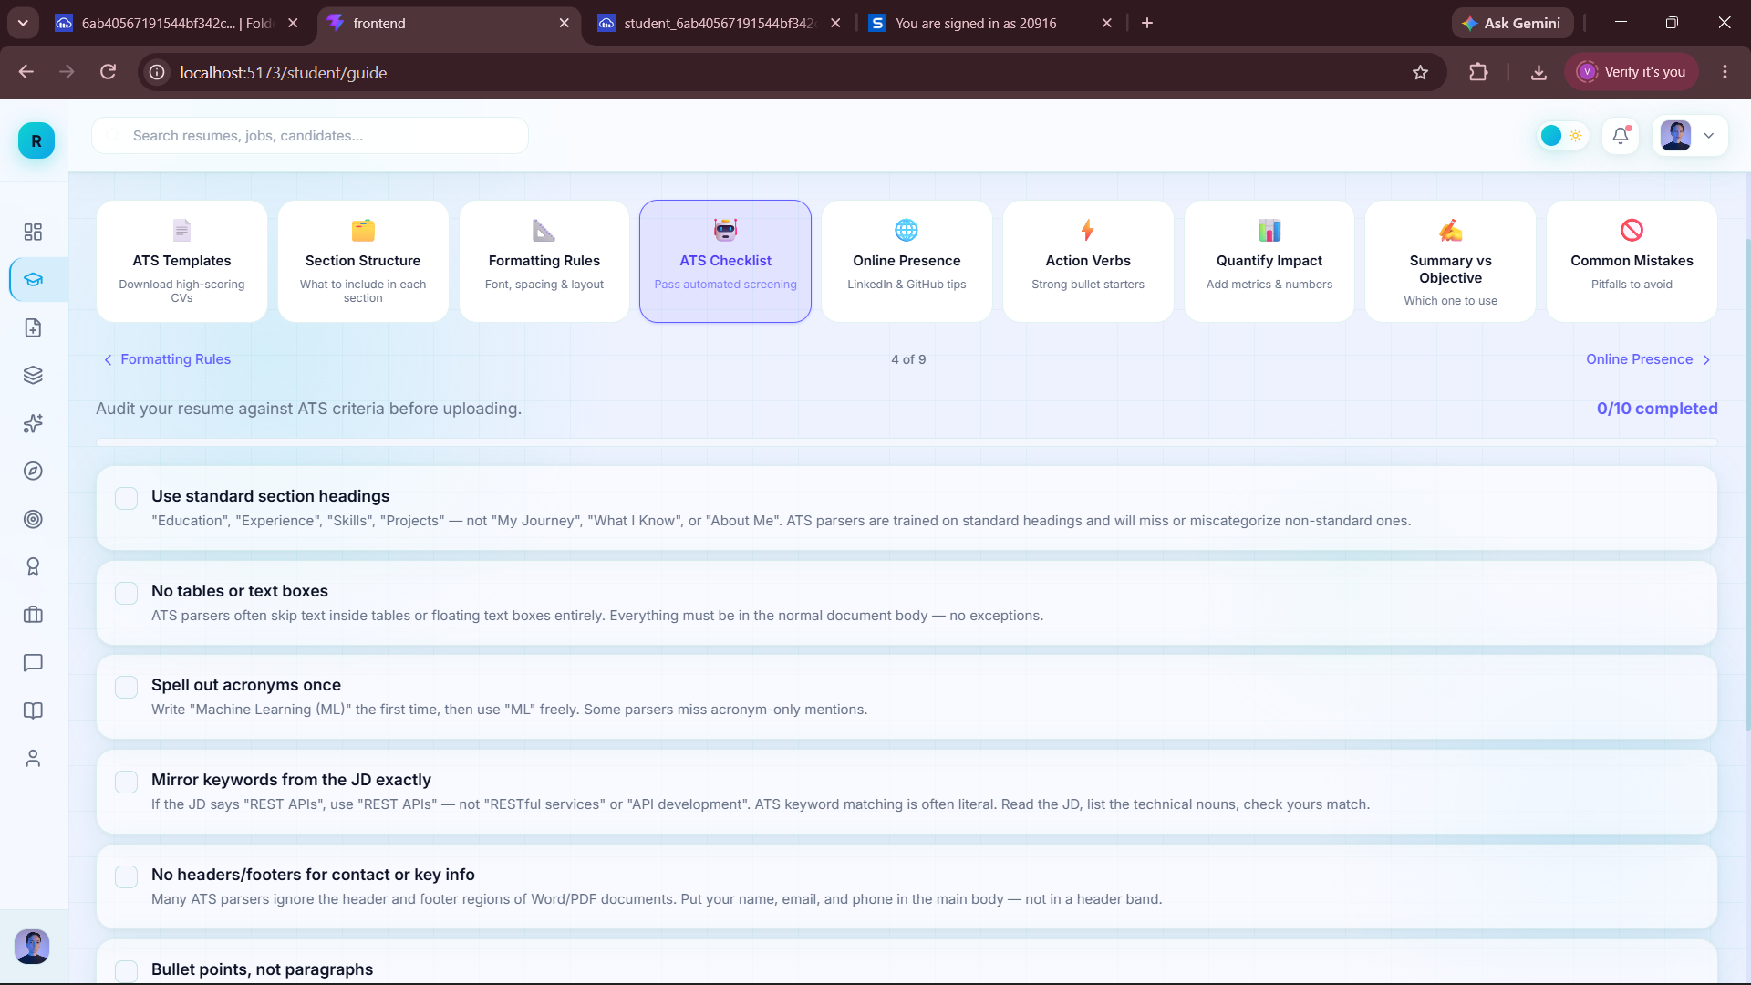
Fig 1.3: Resume Guide Page

Slide 19
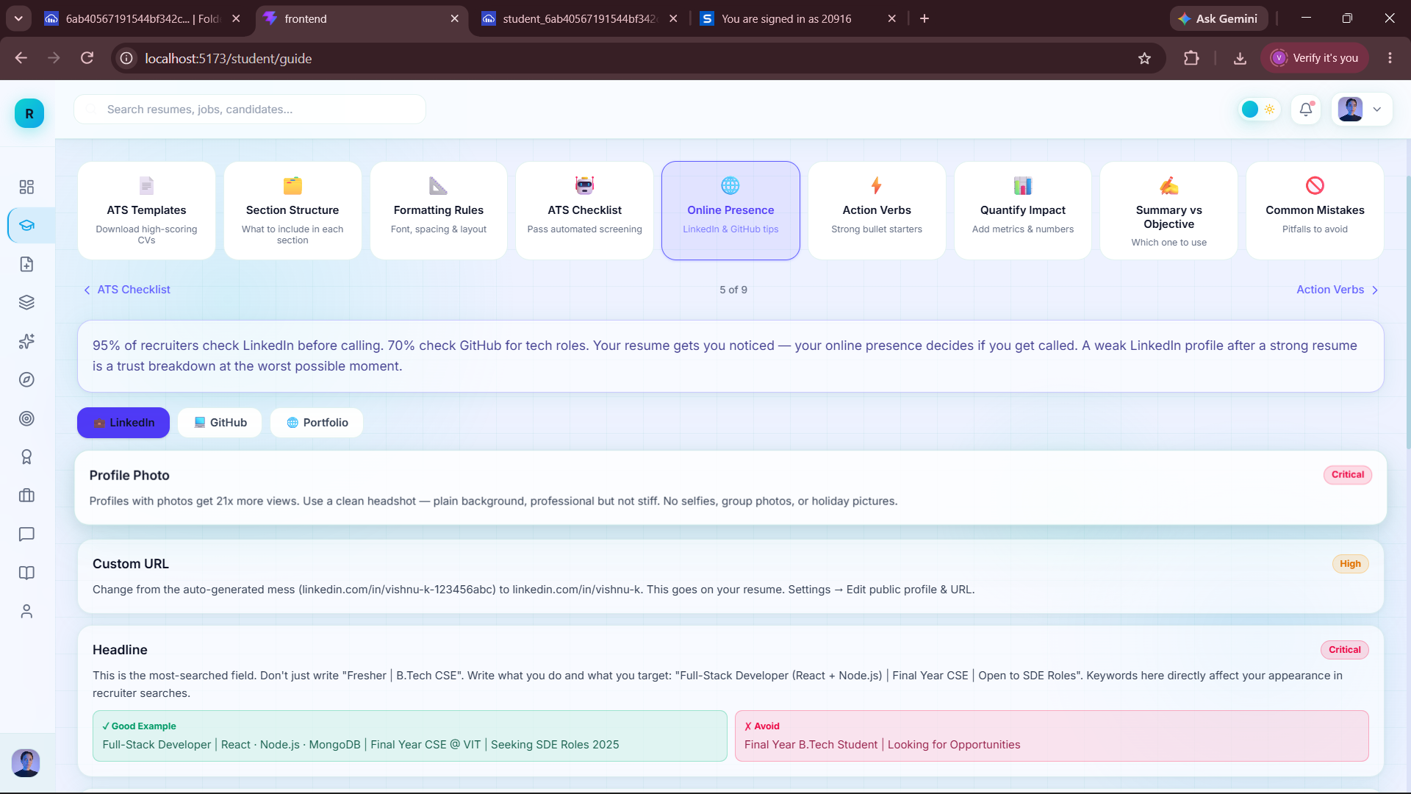
Fig 1.3: Resume Guide Page

Slide 20
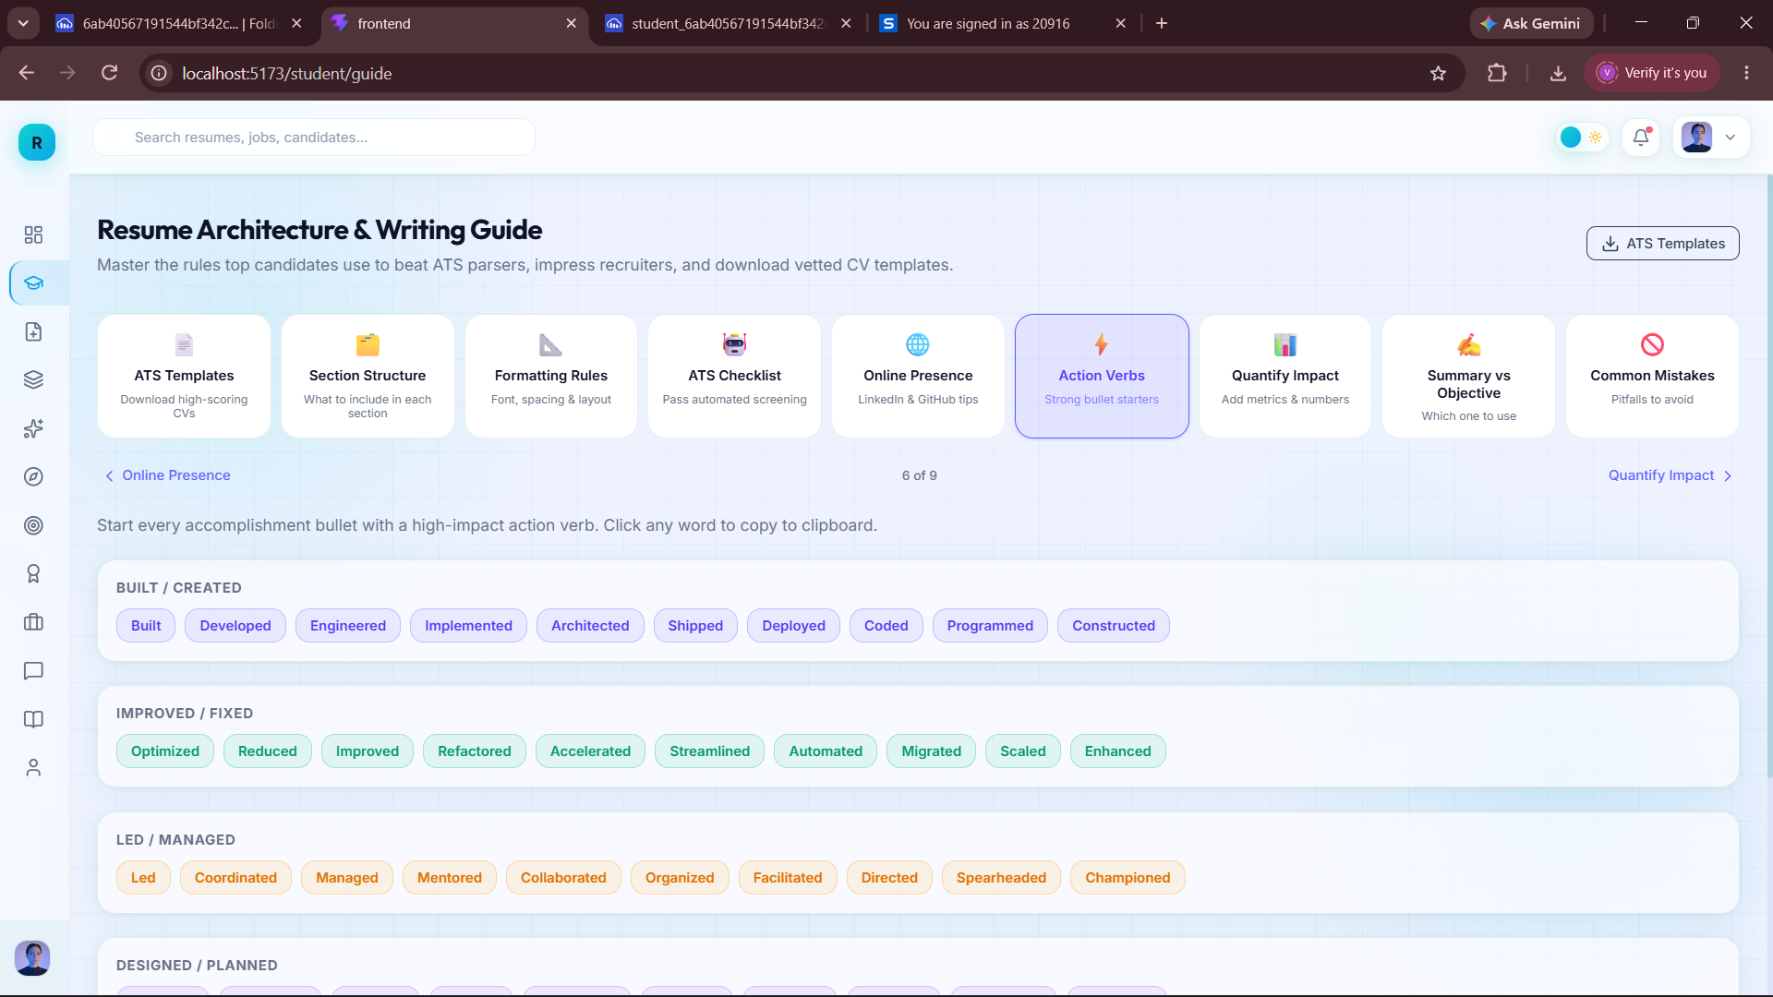
Fig 1.3: Resume Guide Page

Slide 21
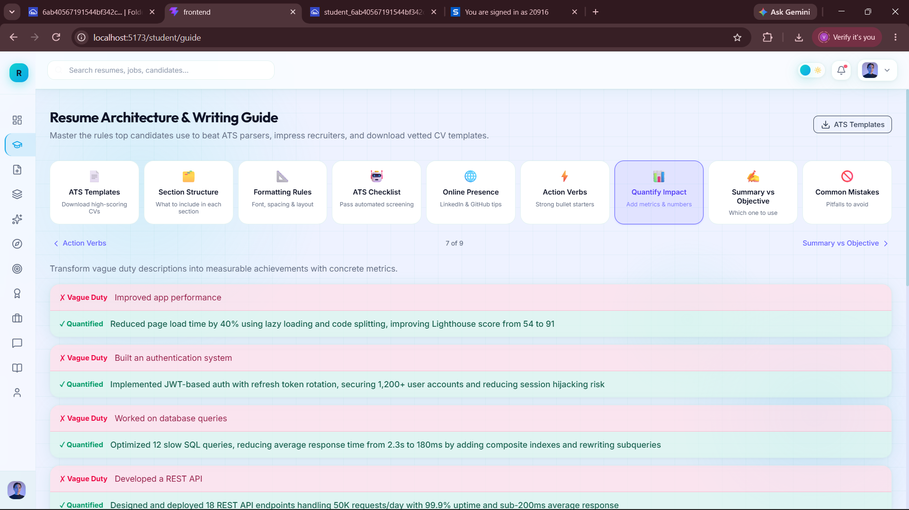
Fig 1.3: Resume Guide Page

Slide 22
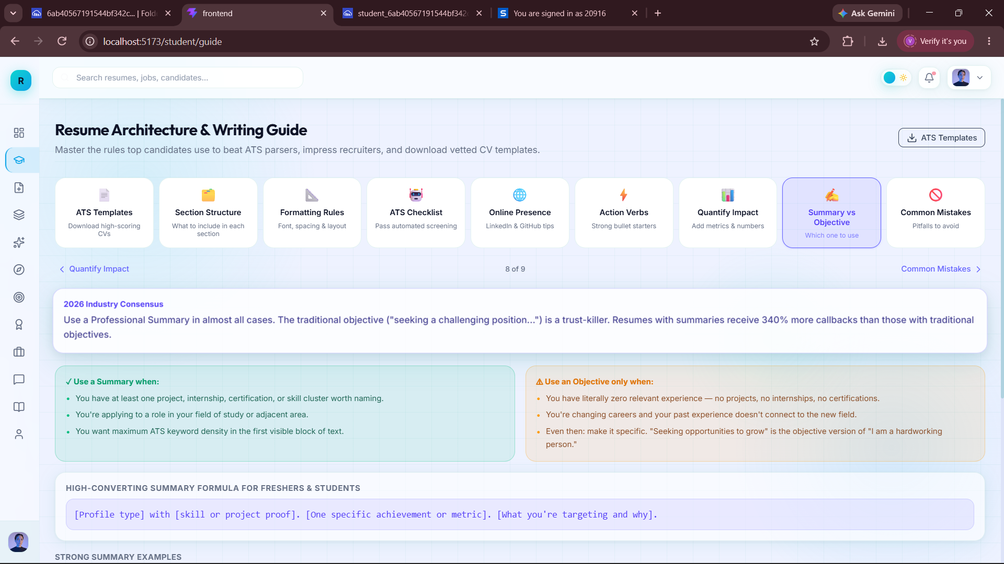
Fig 1.3: Resume Guide Page

Slide 23
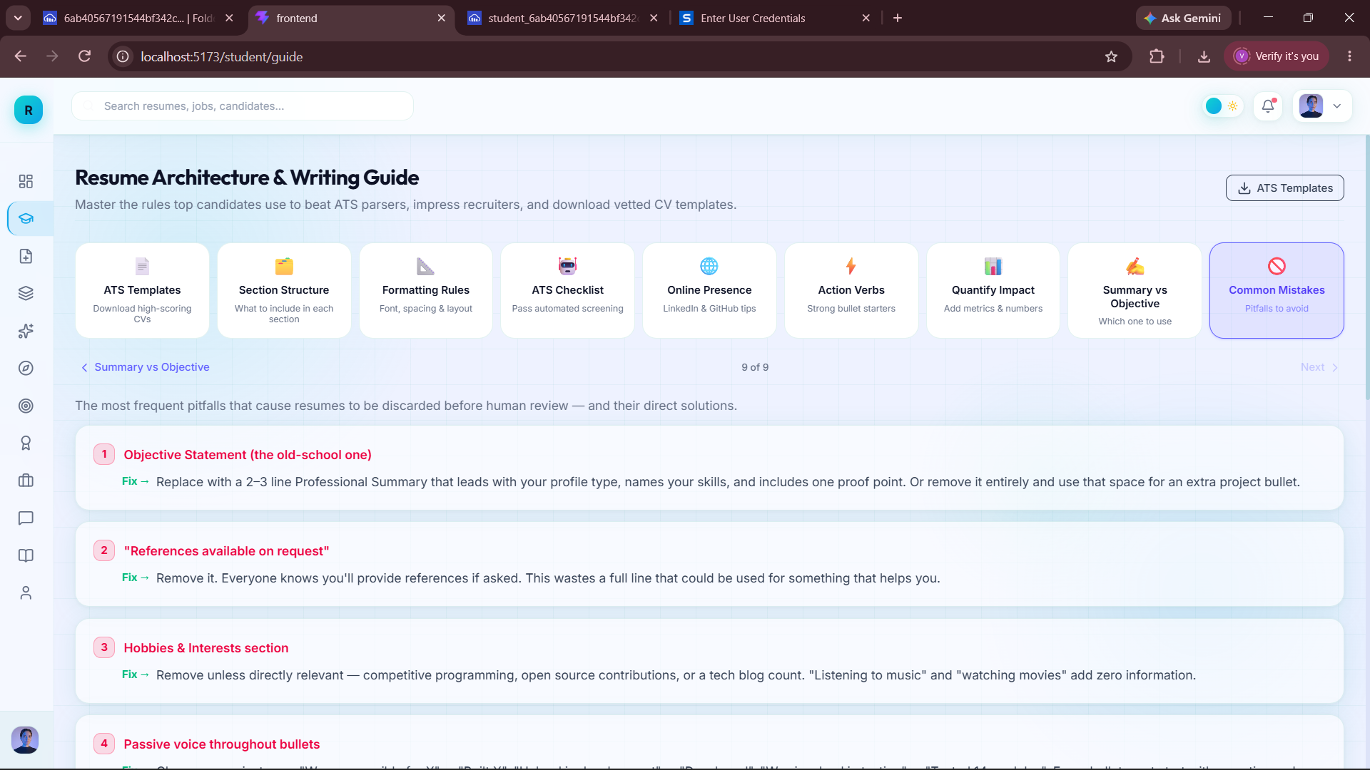
Fig 1.3: Resume Guide Page

Slide 24
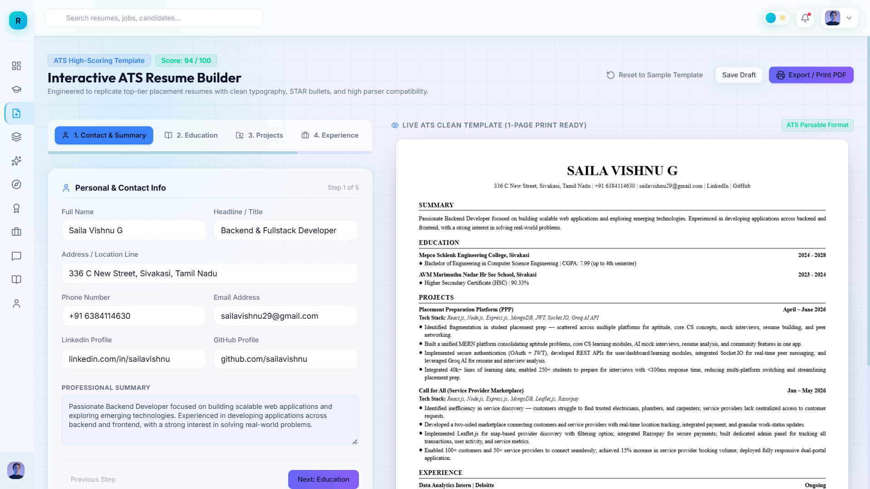
Fig 1.4: Resume Builder Page

Slide 25
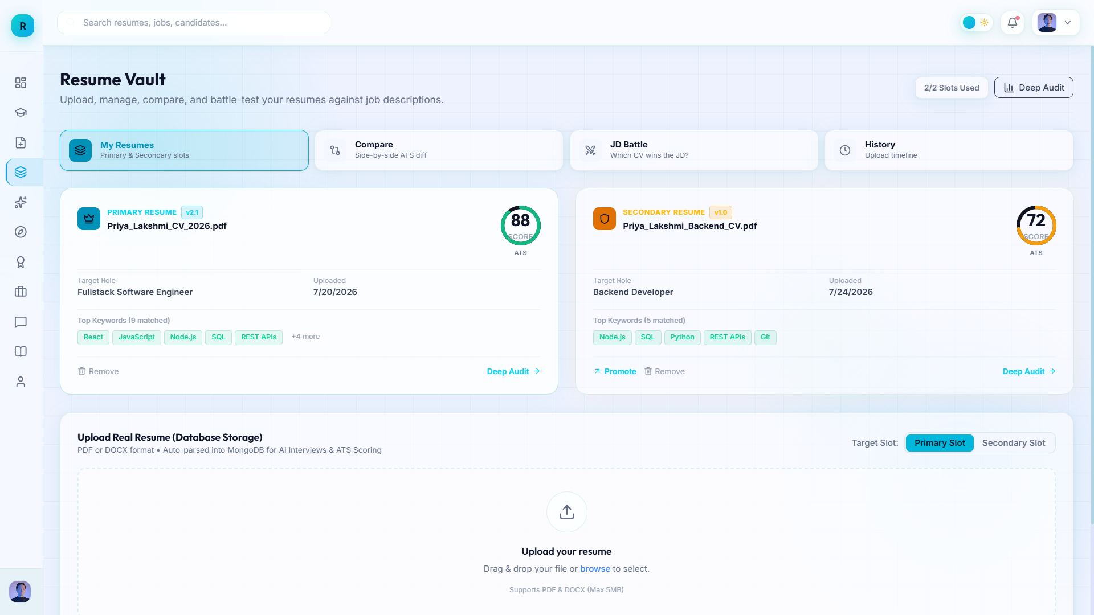
Fig 1.5: Resume Vault (Primary and Secondry Resume)

Slide 26
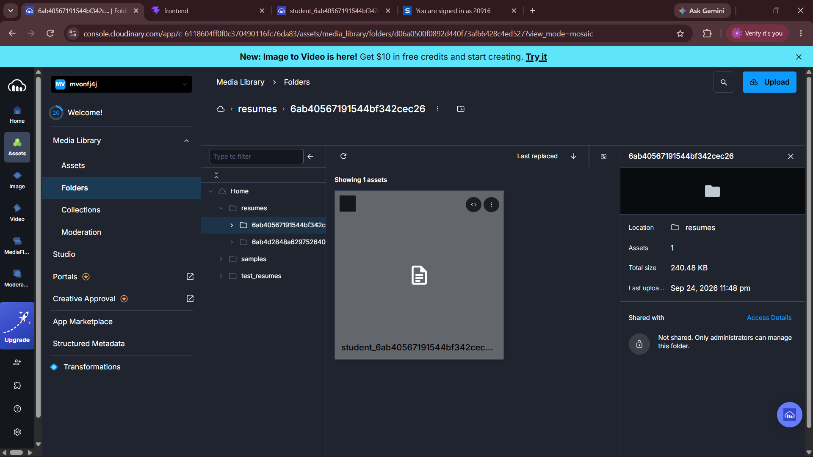
Fig 1.5: Resume Vault (Primary and Secondry Resume)

Slide 27
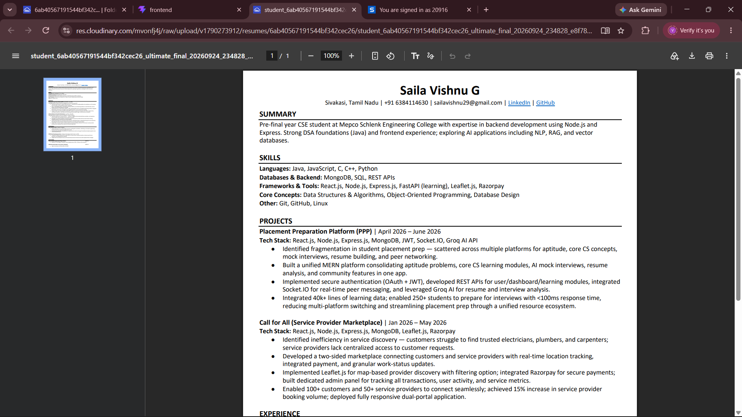
Fig 1.5: Resume Vault (Primary and Secondry Resume)

Slide 28
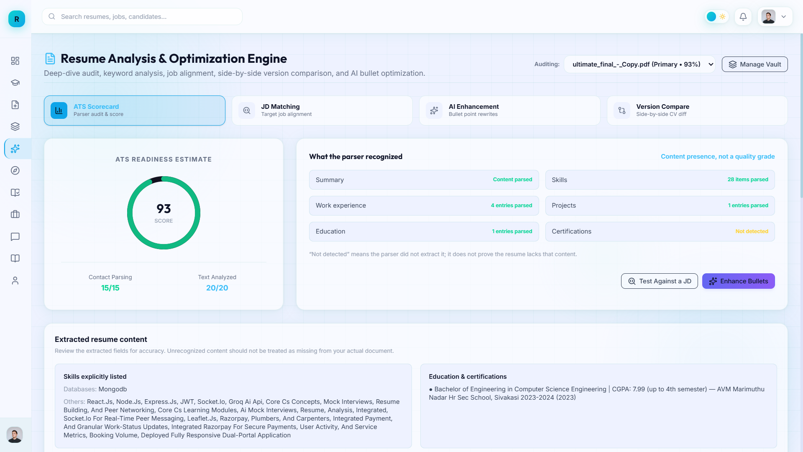
Fig 1.7: Resume Analysis page (ATS check)

Slide 29
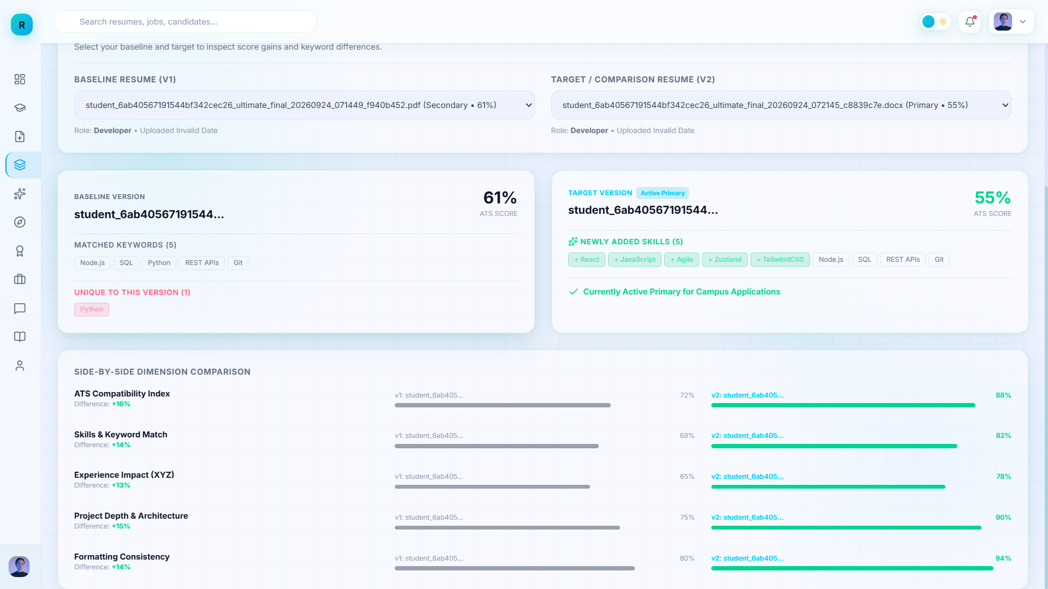
Fig 1.6: Comparision Page

Slide 30
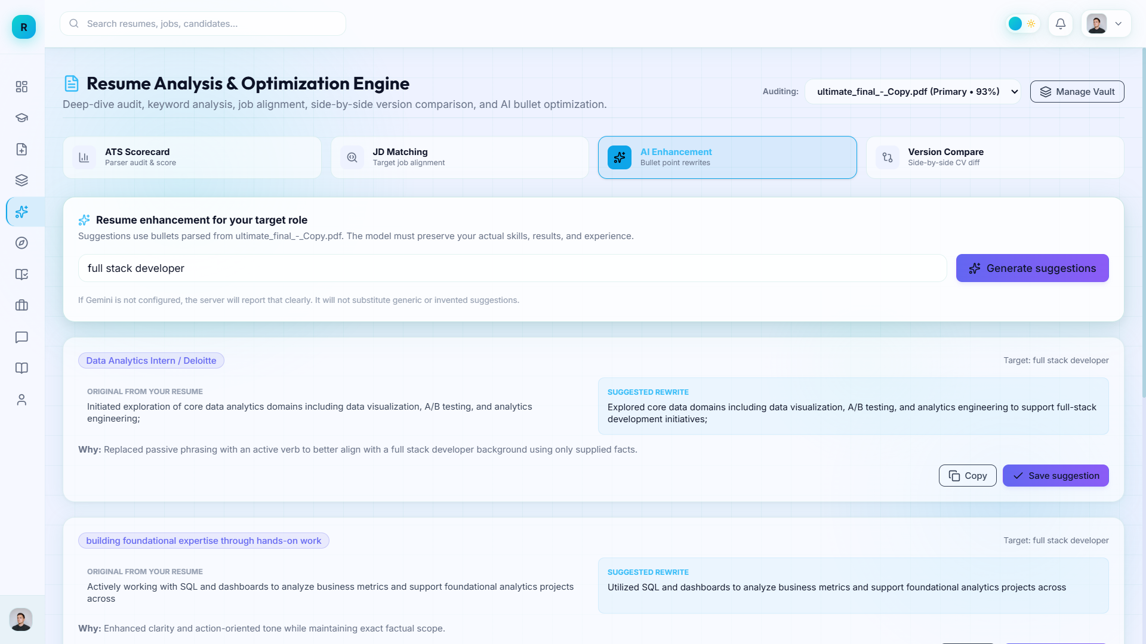
Fig 1.8 : AI Enhancement

Slide 31
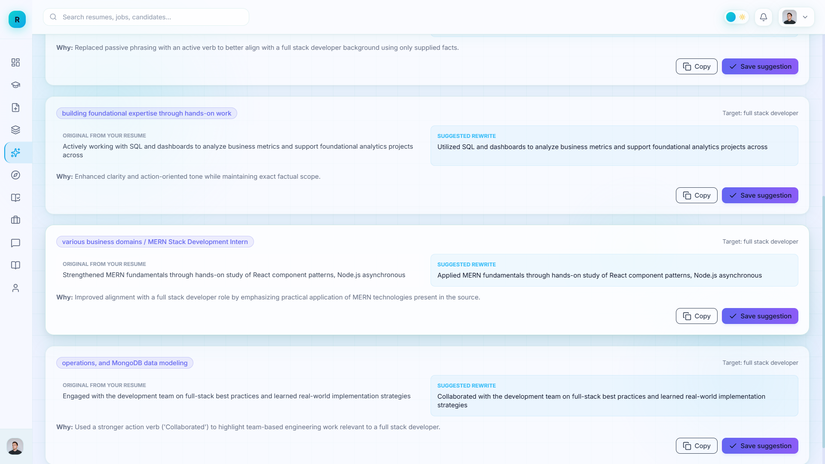
Fig 1.8 : AI Enhancement ( Contd .)

Slide 32
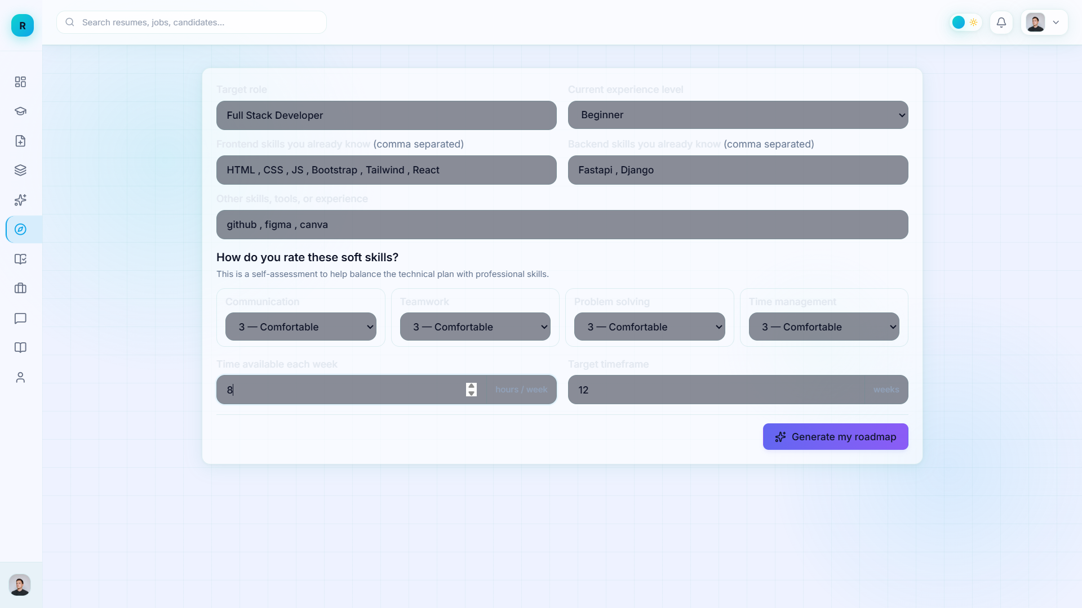
Fig 1.9: Personalized Roadmap

Slide 33
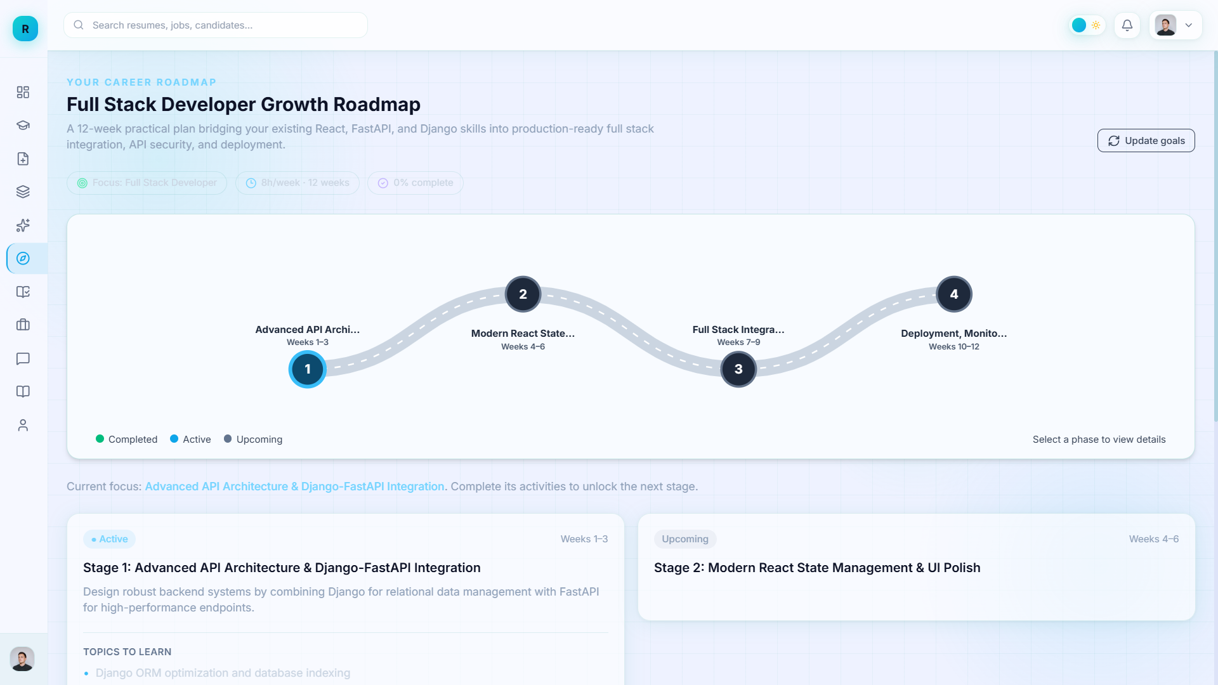
Fig 1.9: Personalized Roadmap (Contd .)

Slide 34
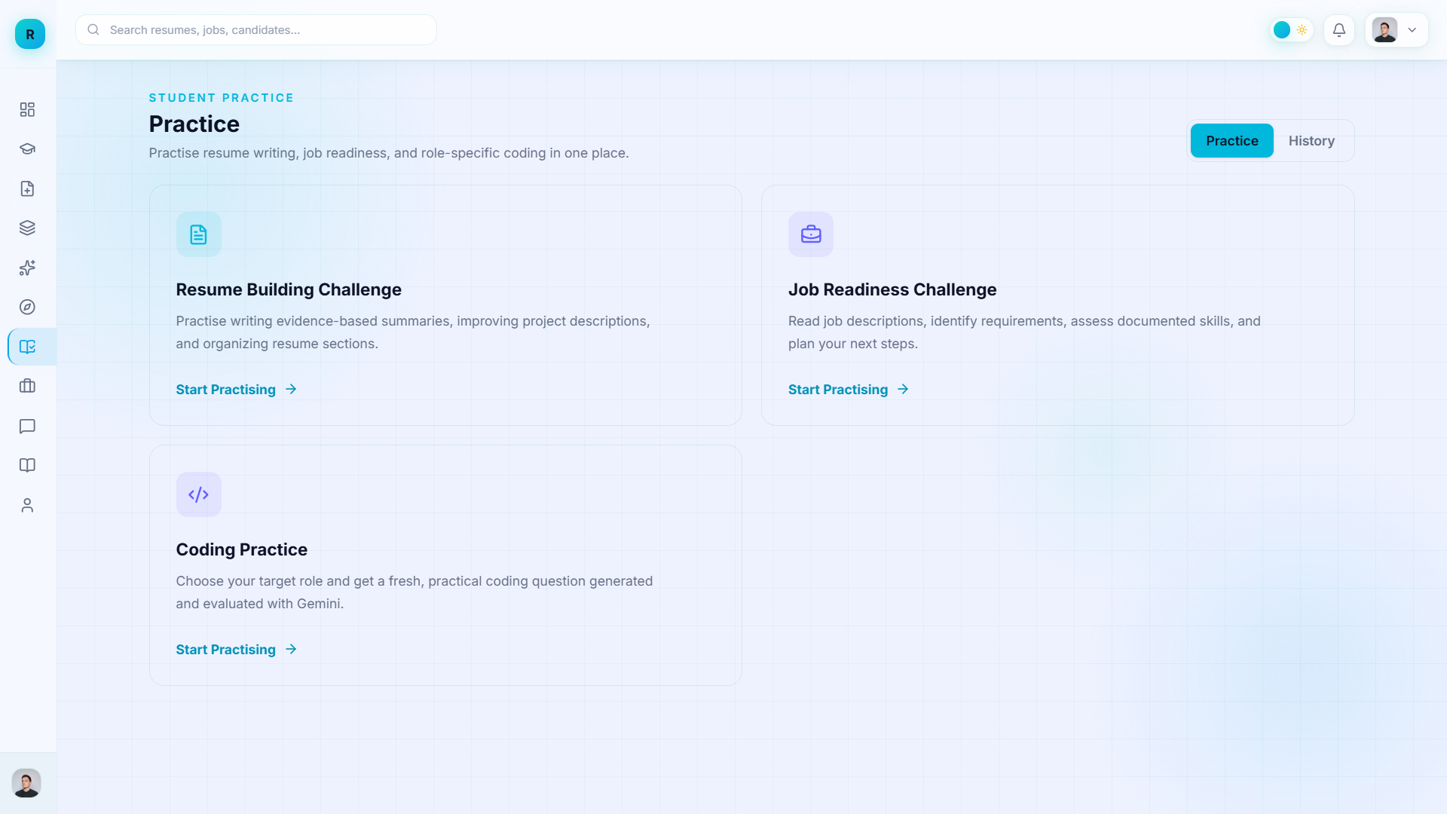
Fig 1.10: Student Practice

Slide 35
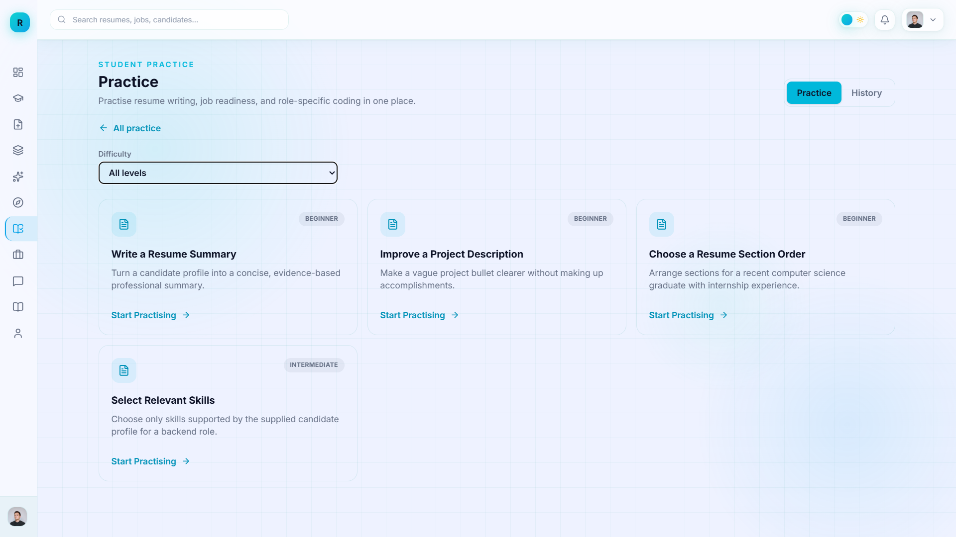
Fig 1.10: Student Practice ( Contd .)

Slide 36
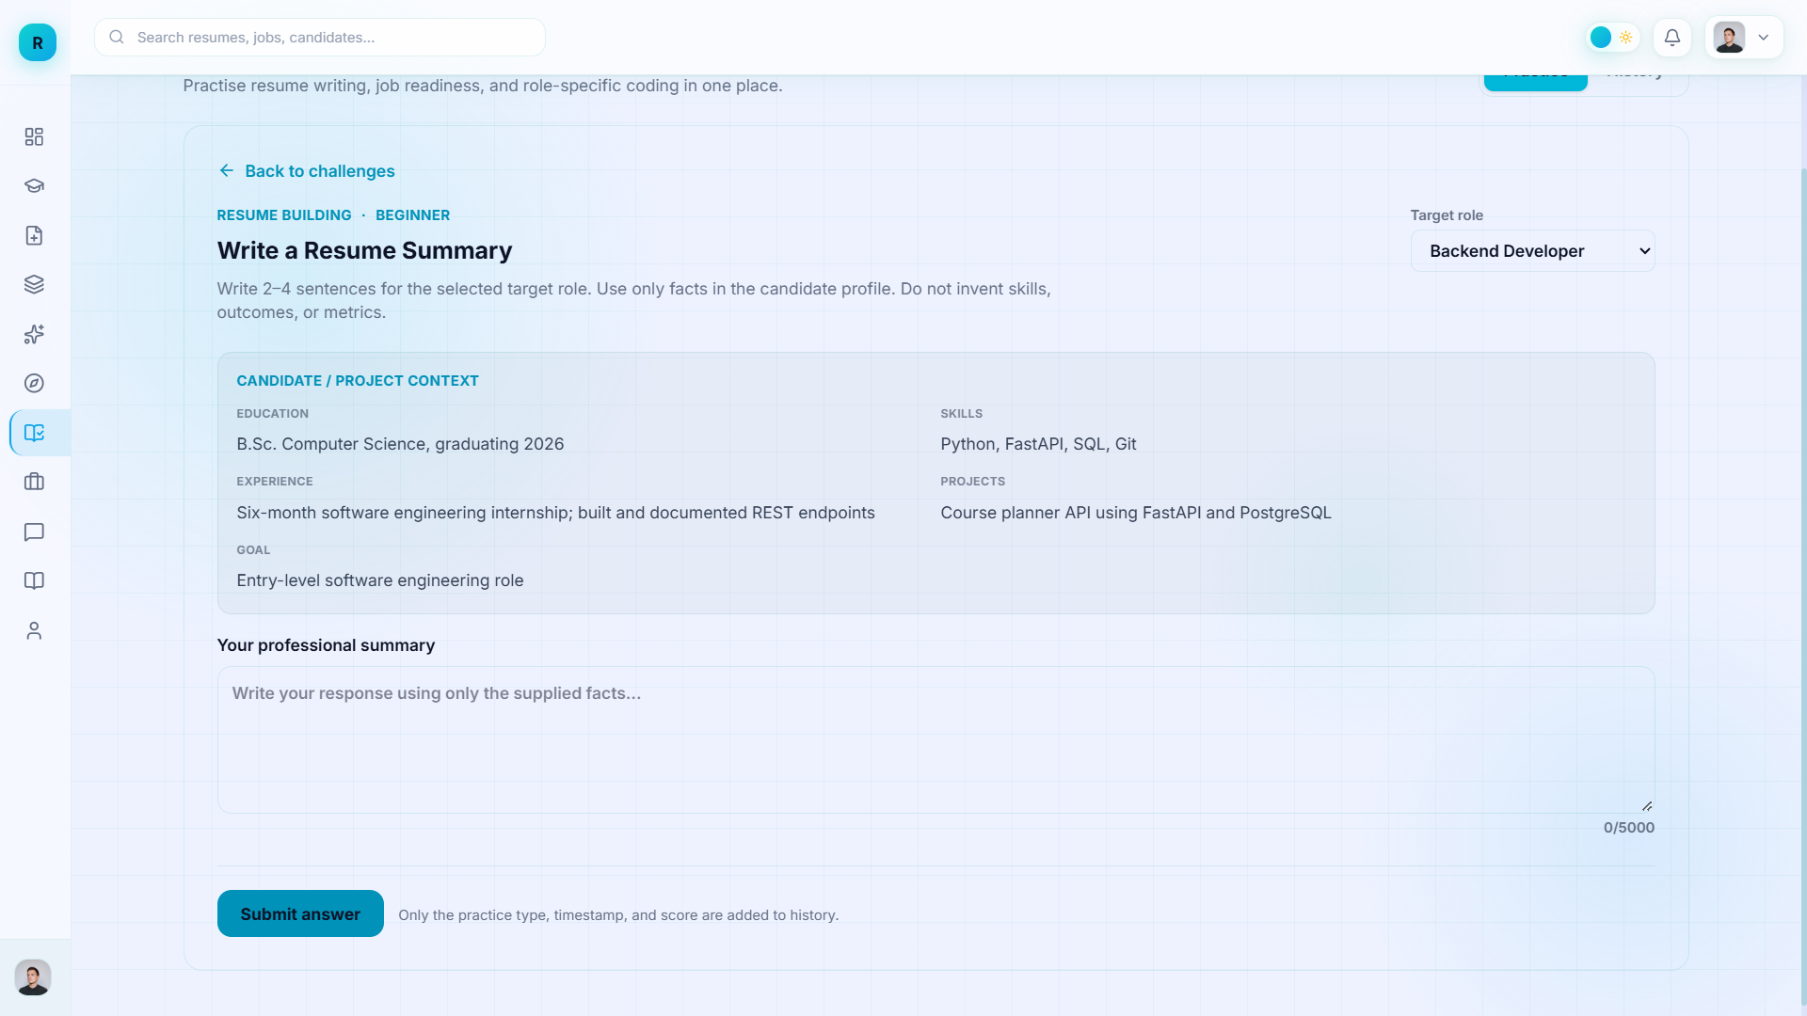
Fig 1.10: Student Practice ( Contd .)

Slide 37
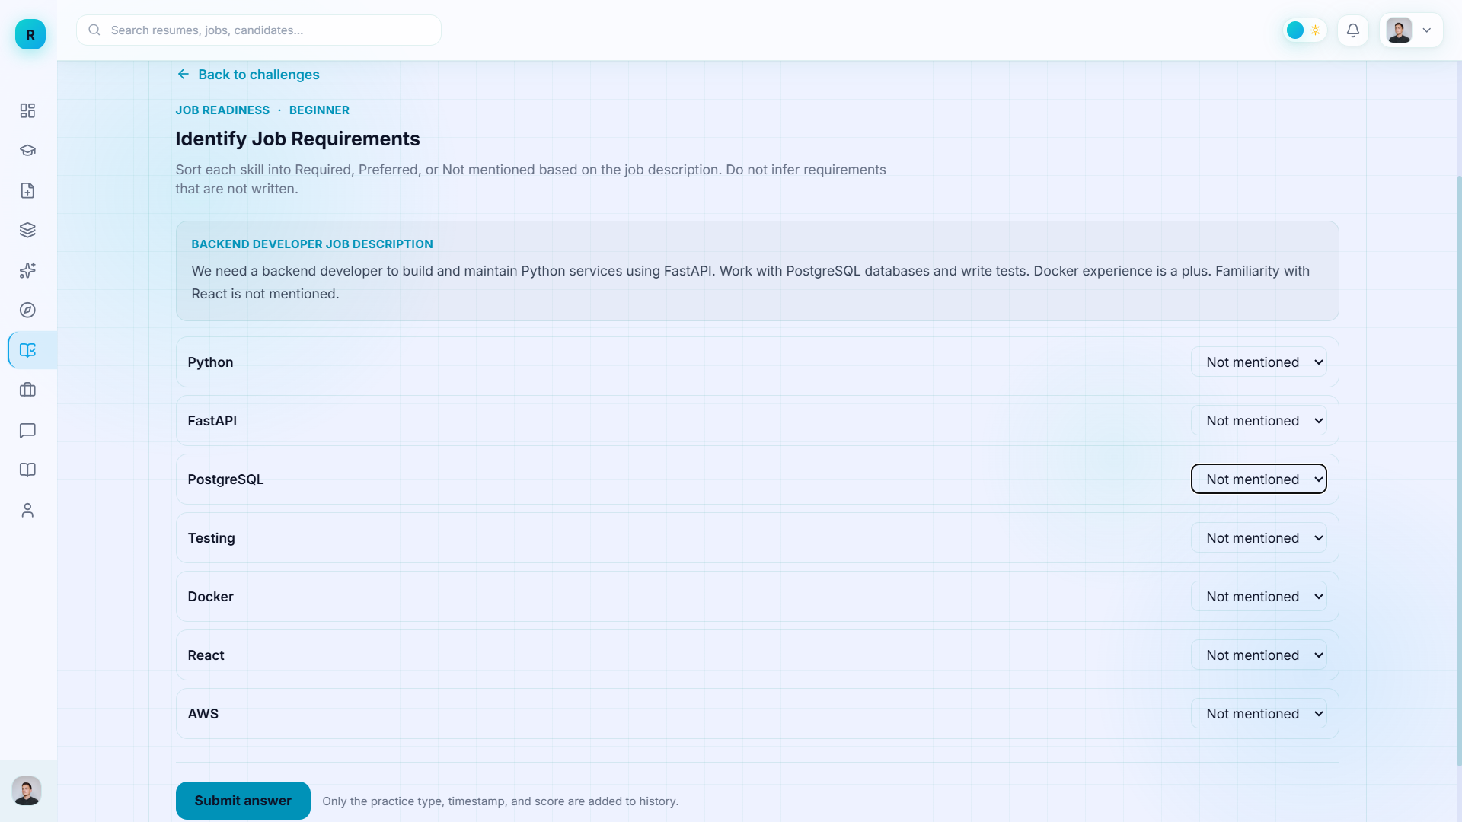
Fig 1.10: Student Practice ( Contd .)

Slide 38
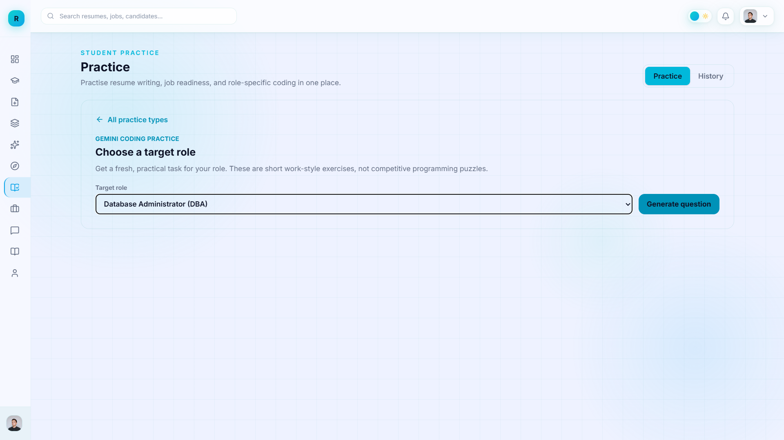
Fig 1.10: Student Practice ( Contd .)

Slide 39
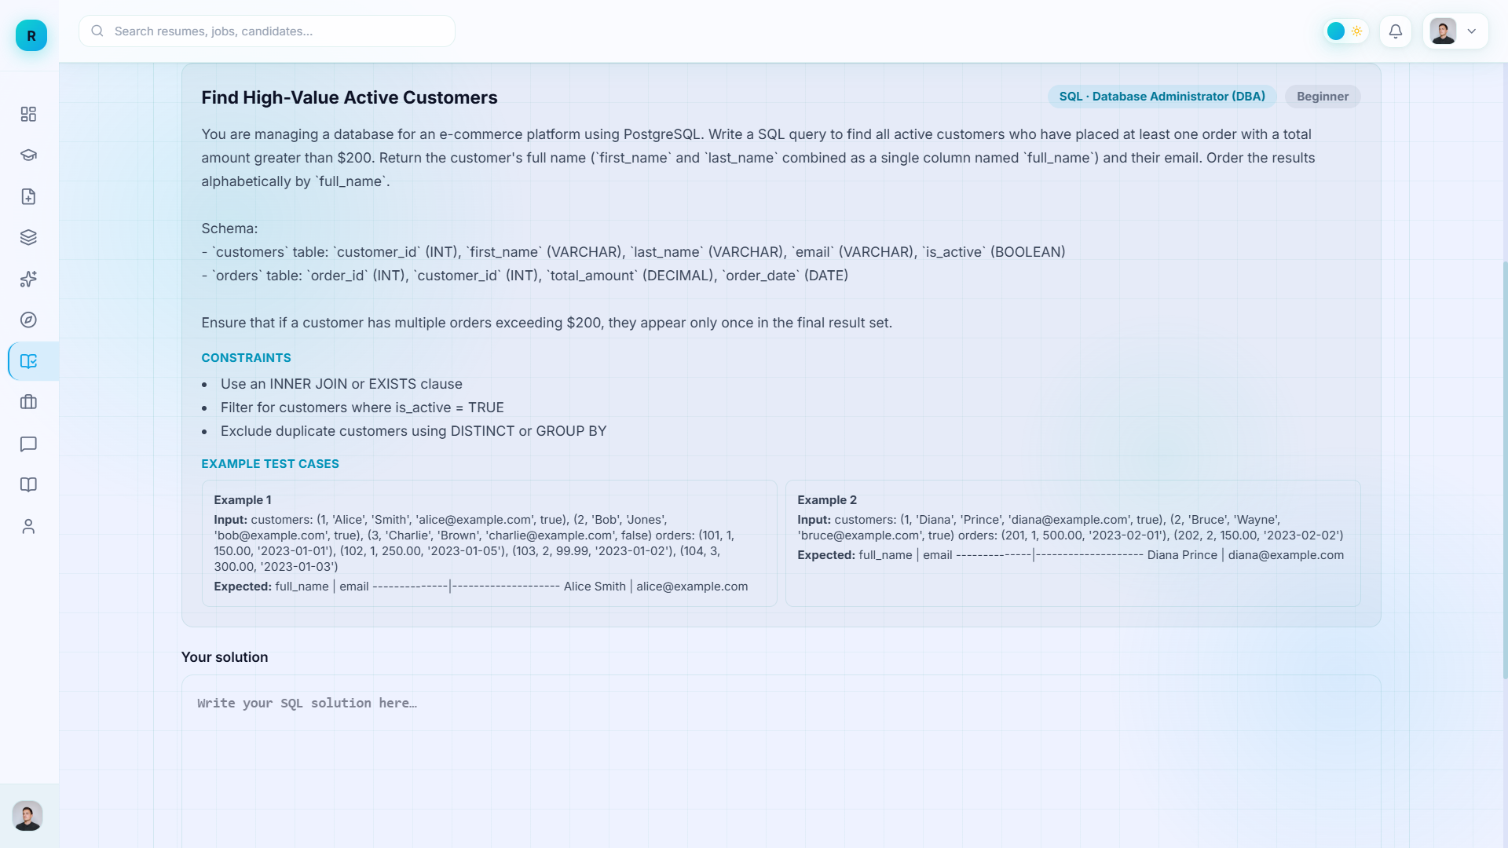
Fig 1.10: Student Practice ( Contd .)

Slide 40
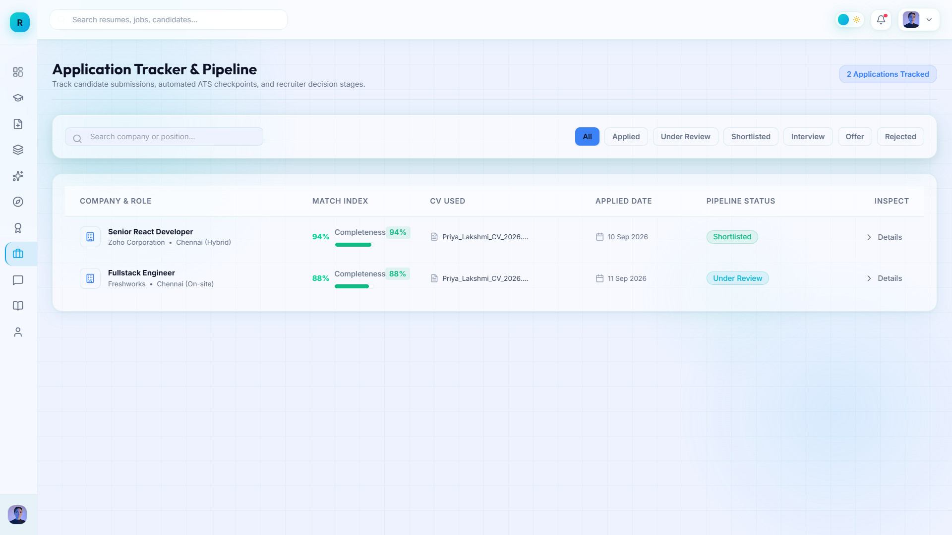
Fig 1.10: Applications Tracker

Slide 41
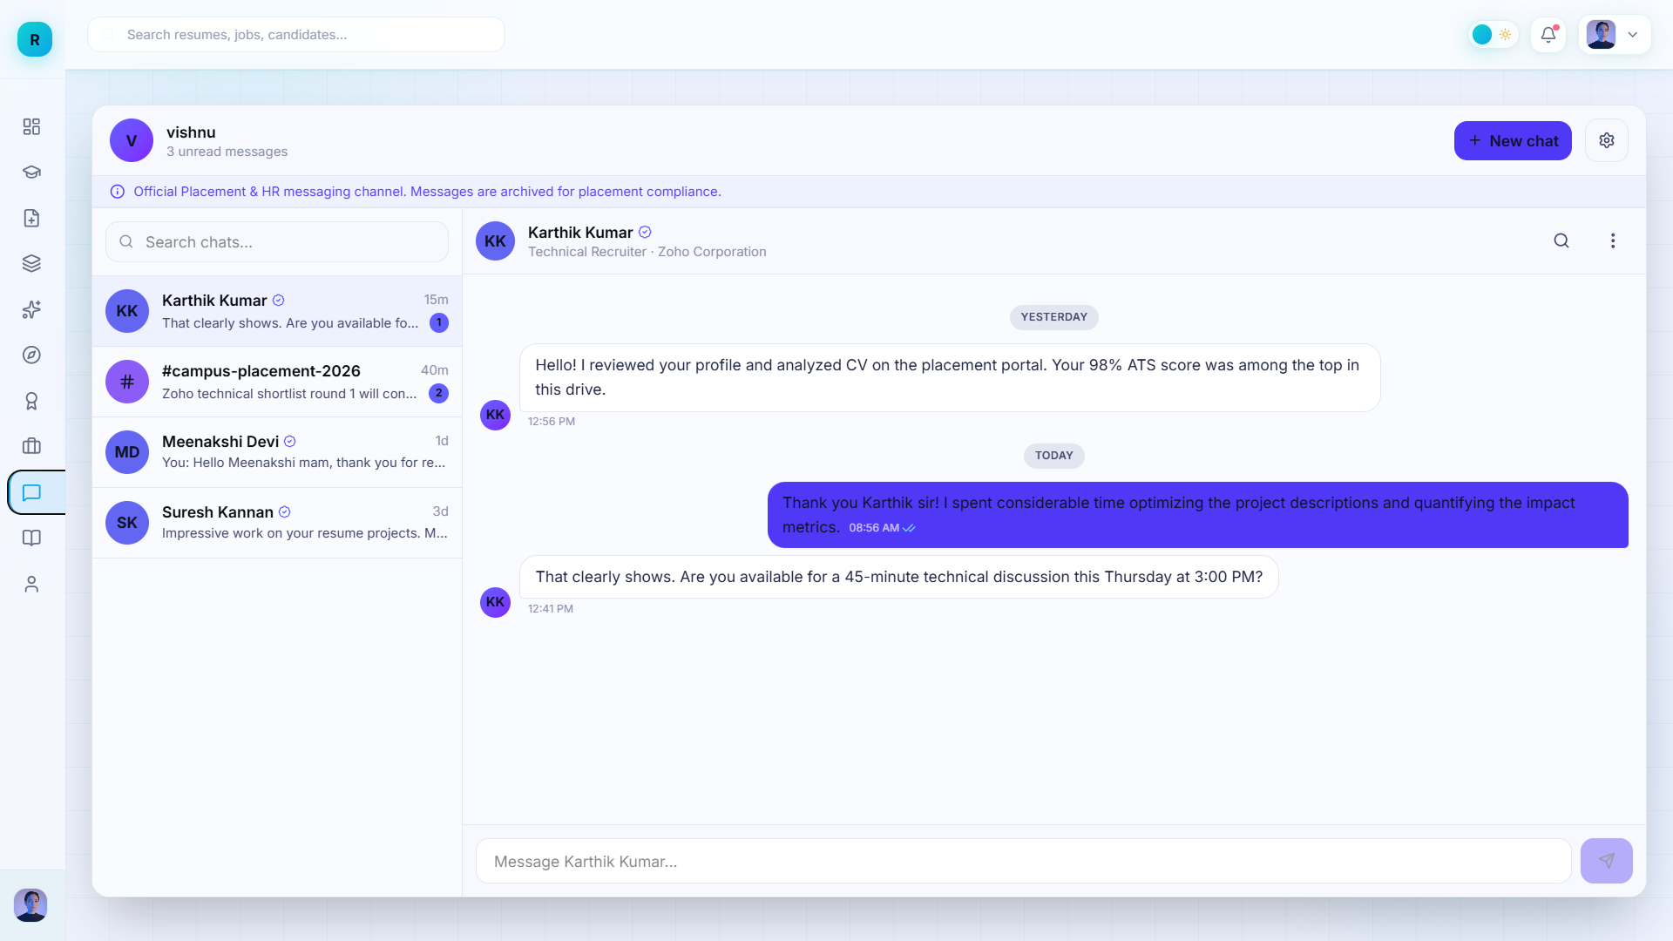
Fig 1.11 : Messaging Page

Slide 42
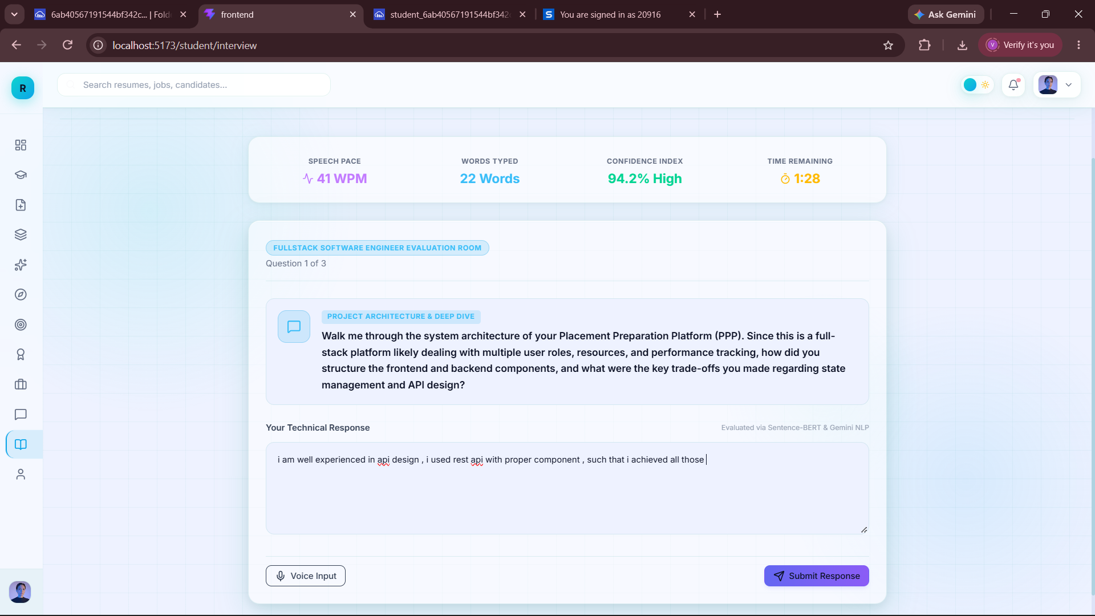
Fig 1.12: AI Interview (Uses Primary Resume)

Slide 43
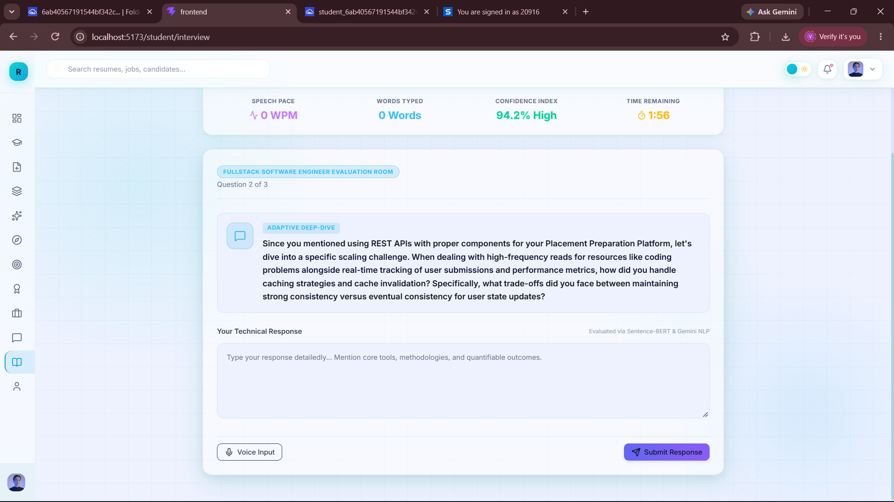
Fig 1.12: AI Interview (Uses Primary Resume)

Slide 44
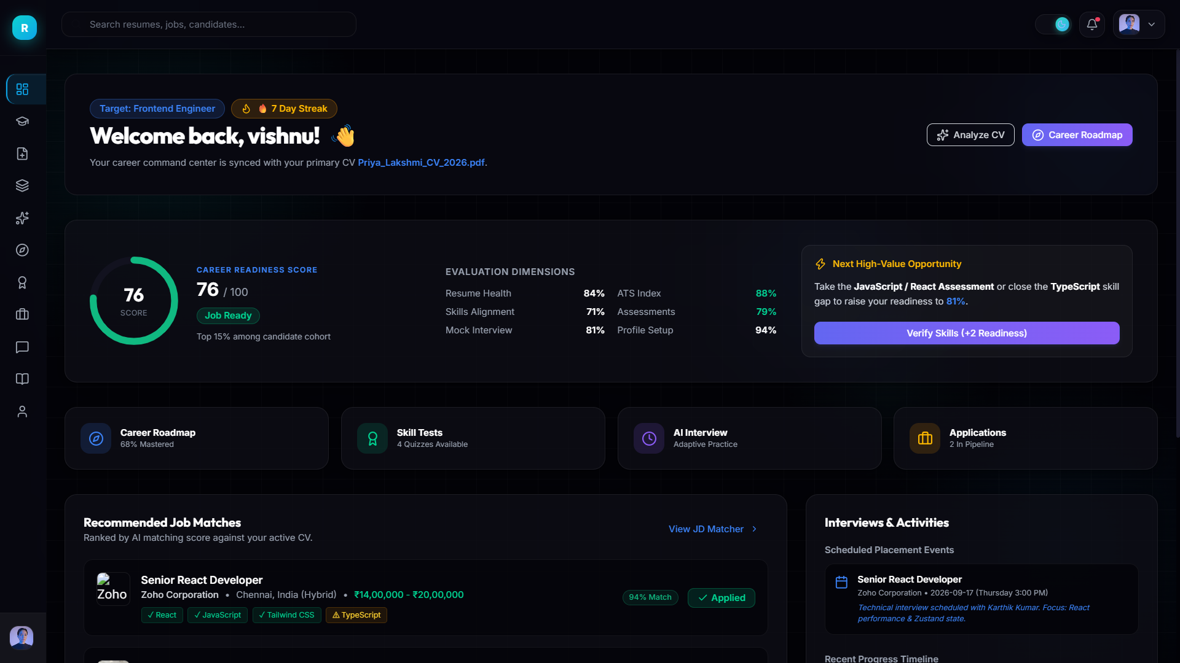
Fig 1.13: Dark Theme ( Dashboard Page)

Slide 45
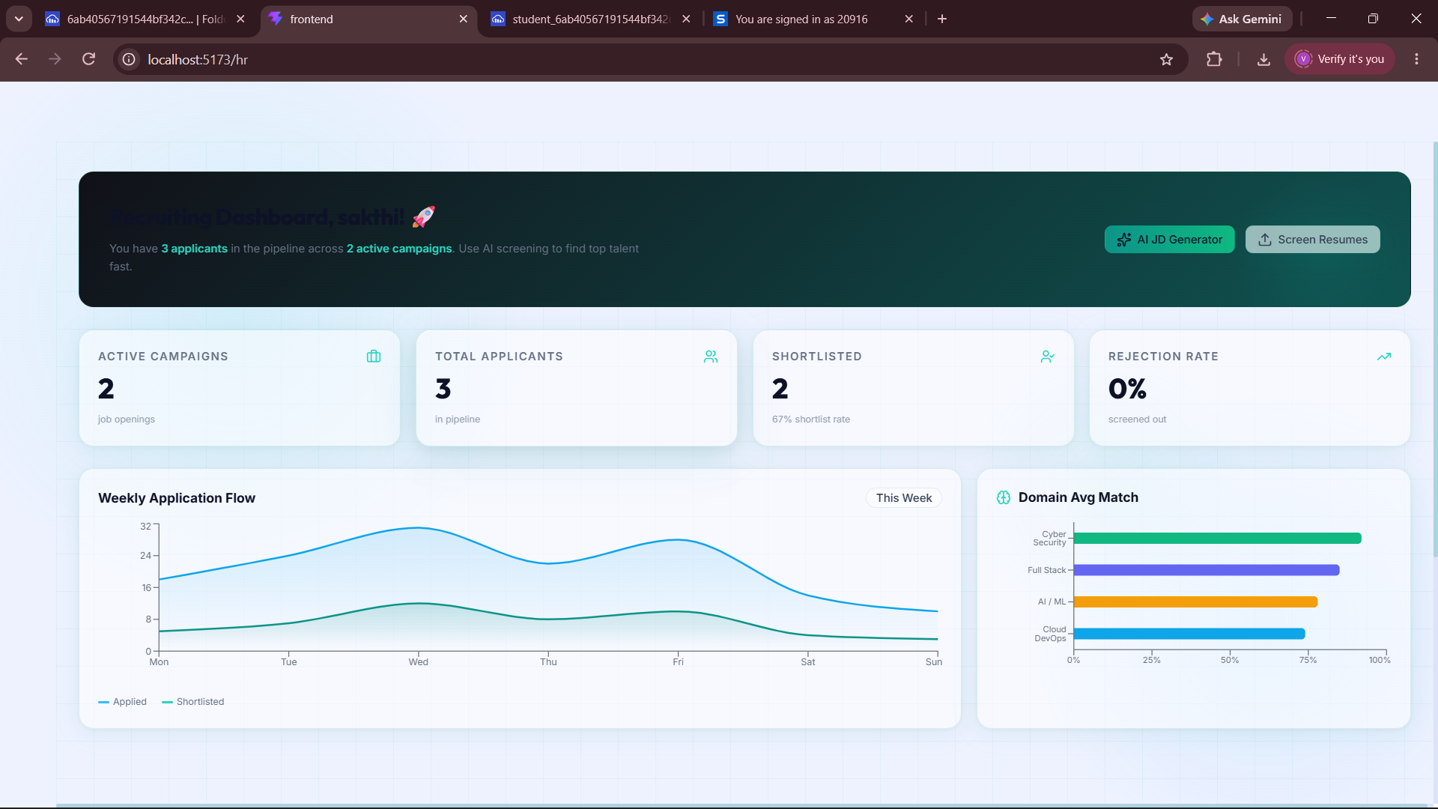
Fig 2.1: HR Dashboard page

Slide 46
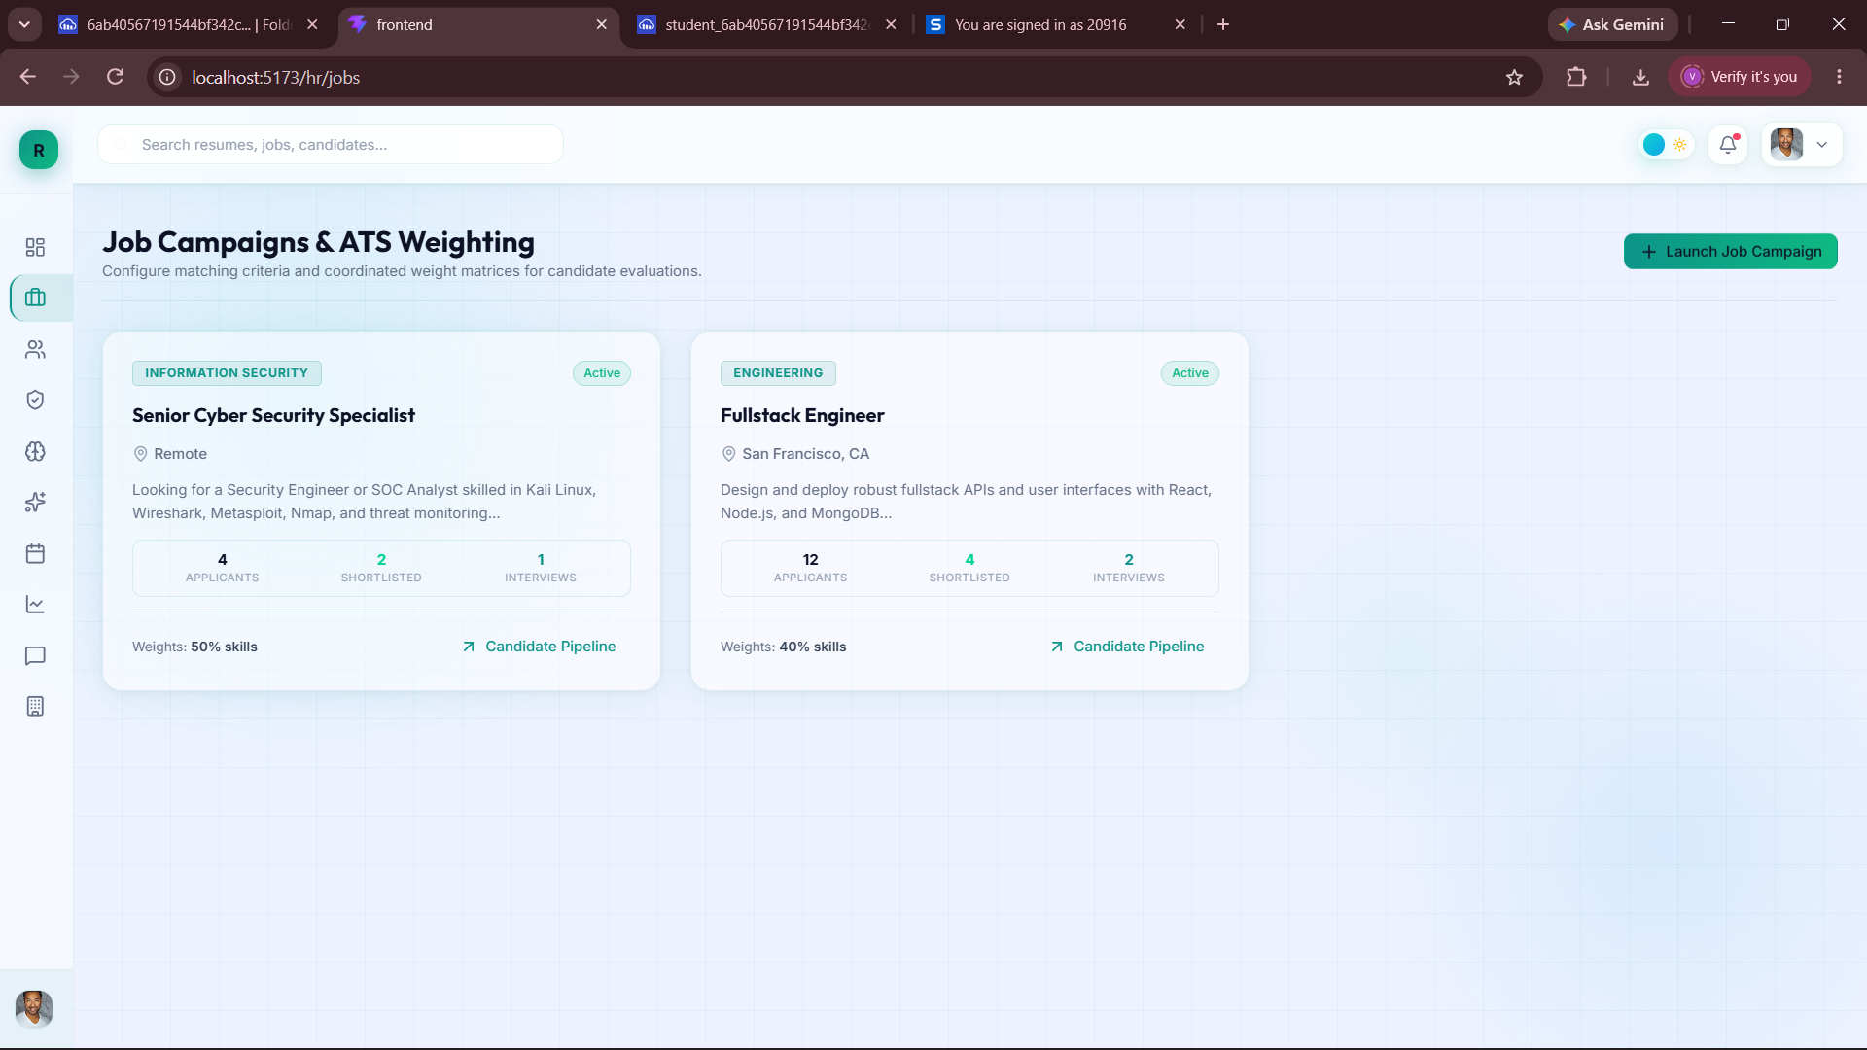
Fig 2.2: Job Posting Page

Slide 47
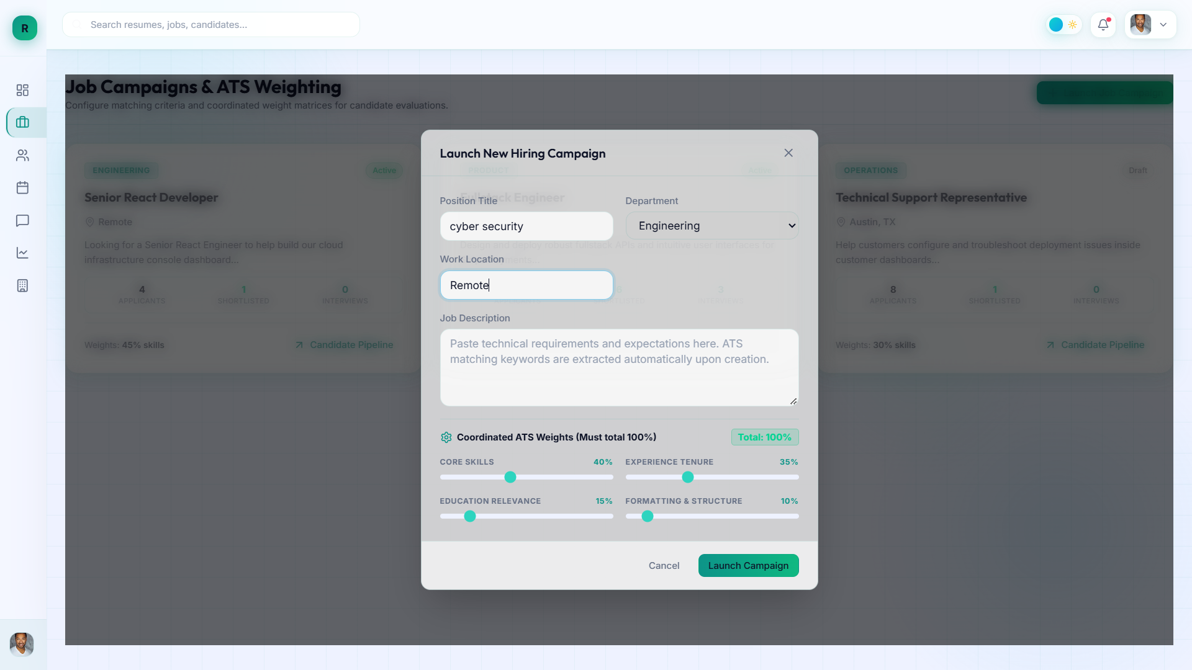
Fig 2.3: New Job Launching Page

Slide 48
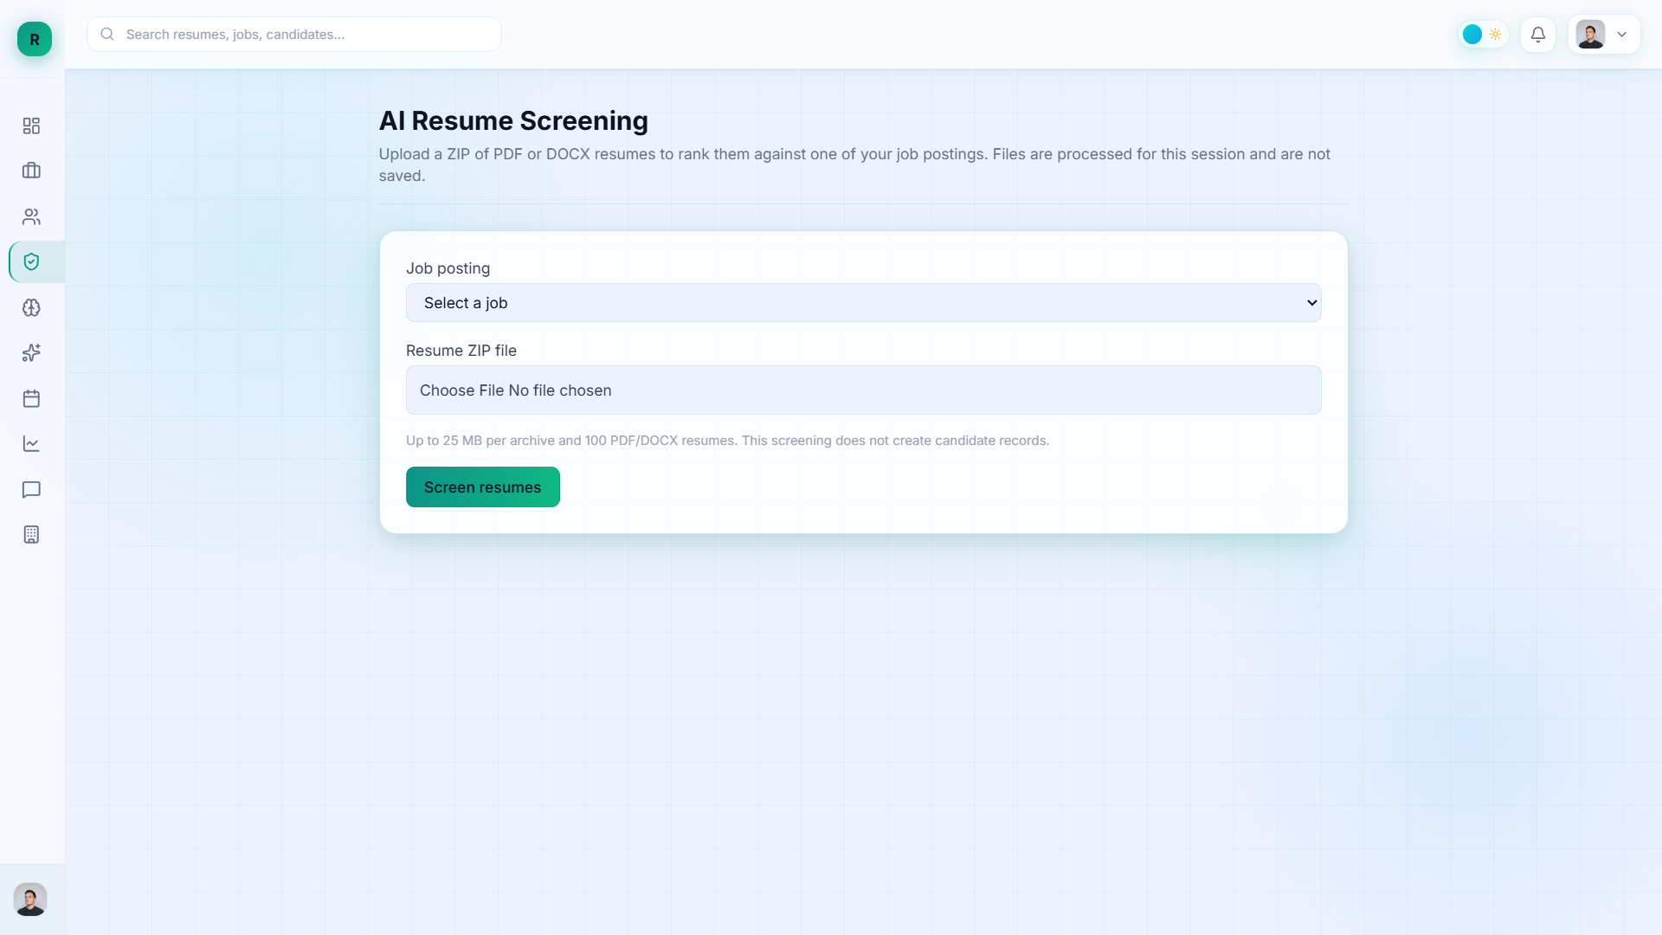
Fig 2.4: Resume Screening

Slide 49
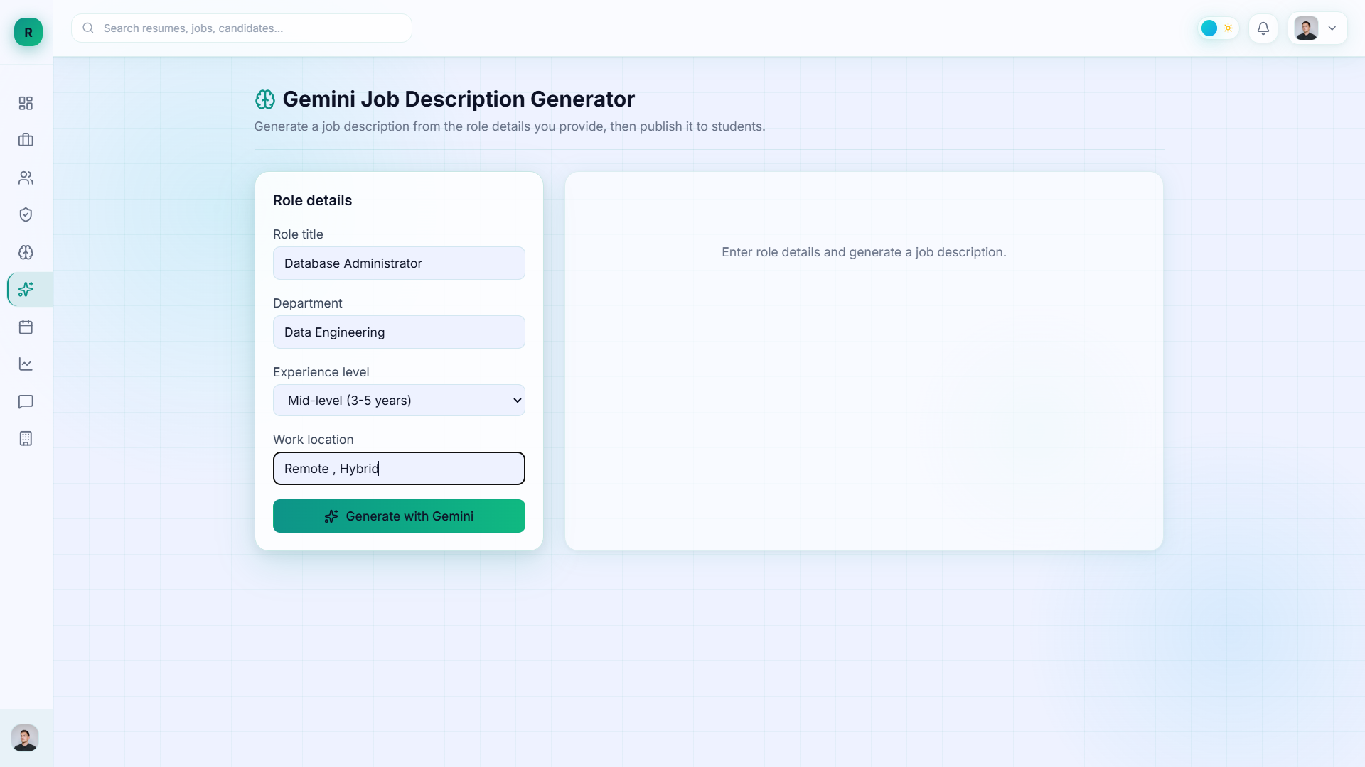
Fig 2.5 : JD Generator

Slide 50
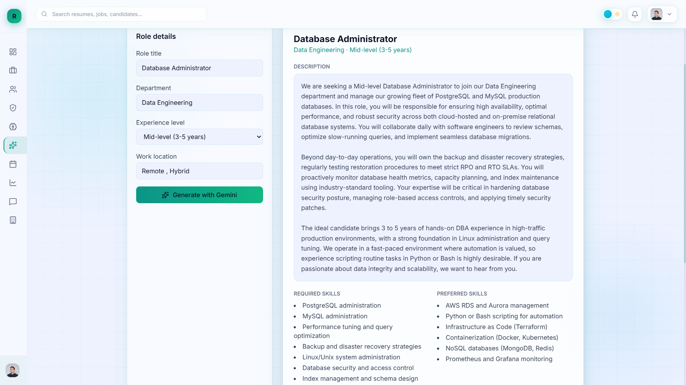
Fig 2.5: Interview With Candidates

Slide 51
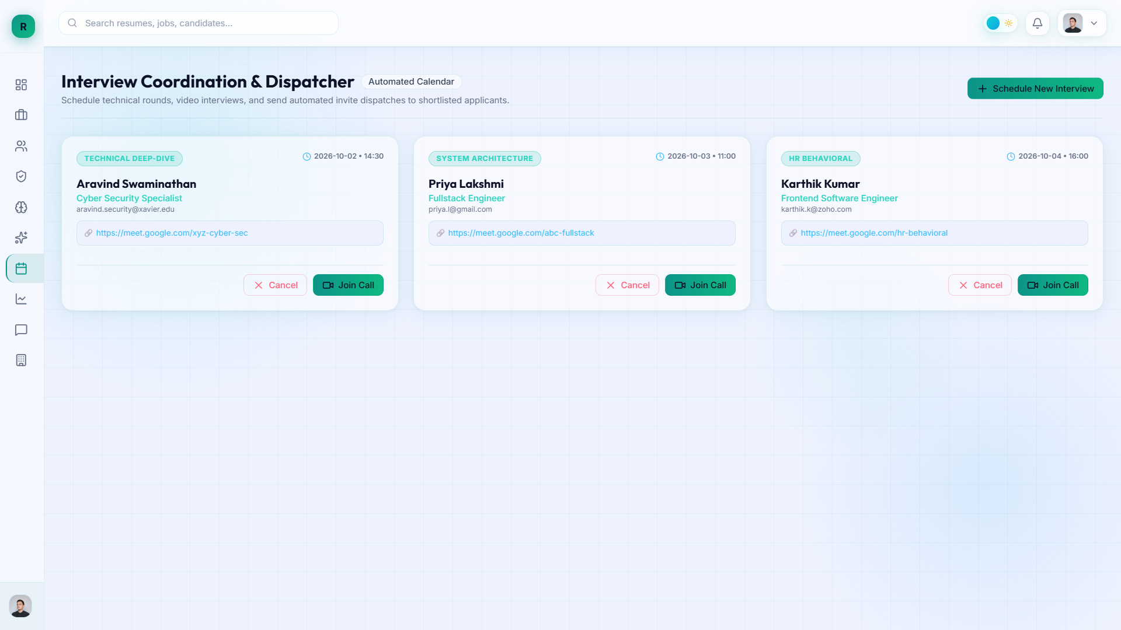
Fig 2.5: Interview With Candidates

Slide 52
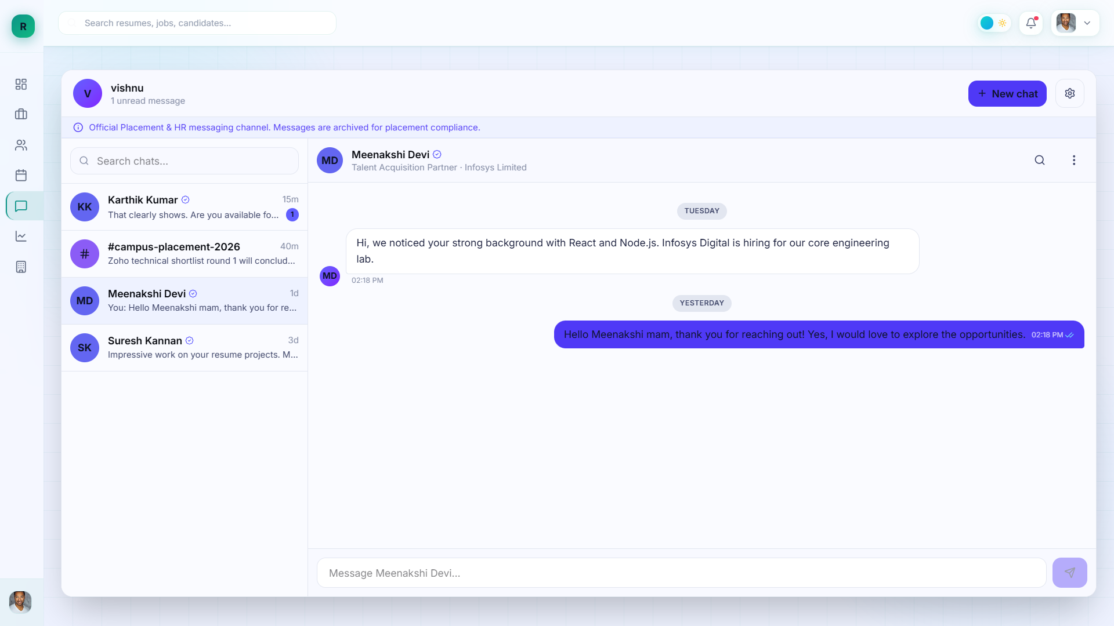
Fig 2.6: Messaging Page (for HR)

Slide 53
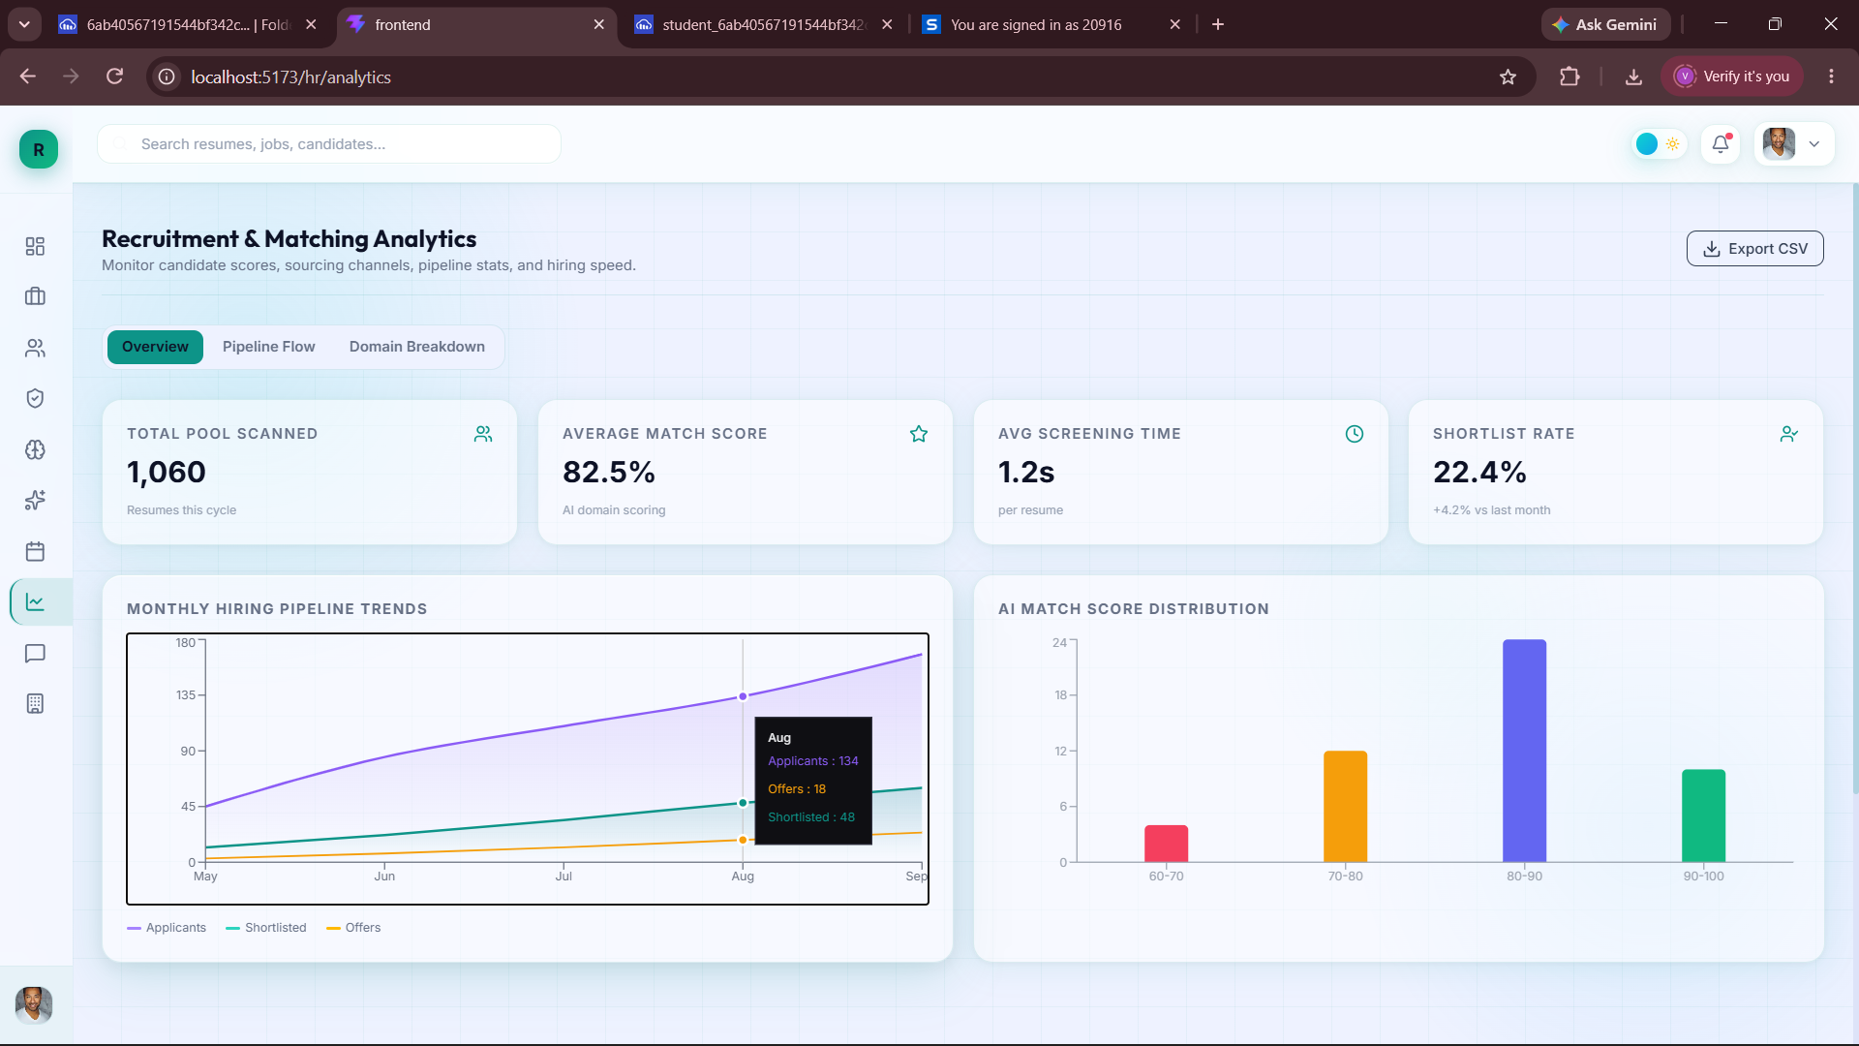
Fig 2.7: Analysis Page

Slide 54
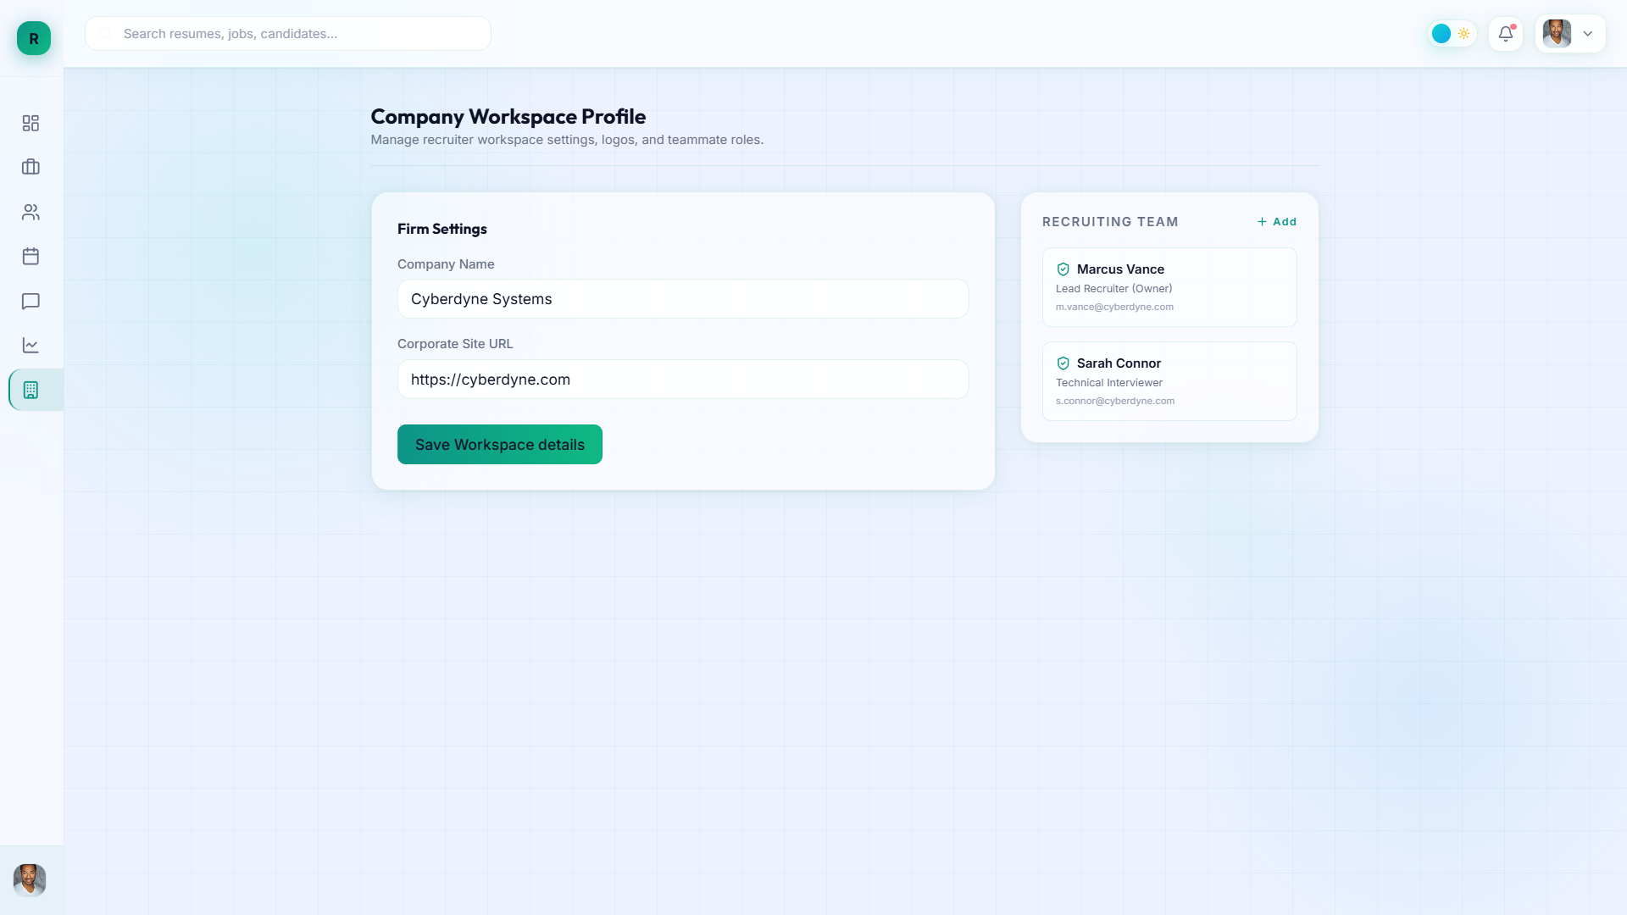
Fig 2.8 : Company Settings Page

Slide 55
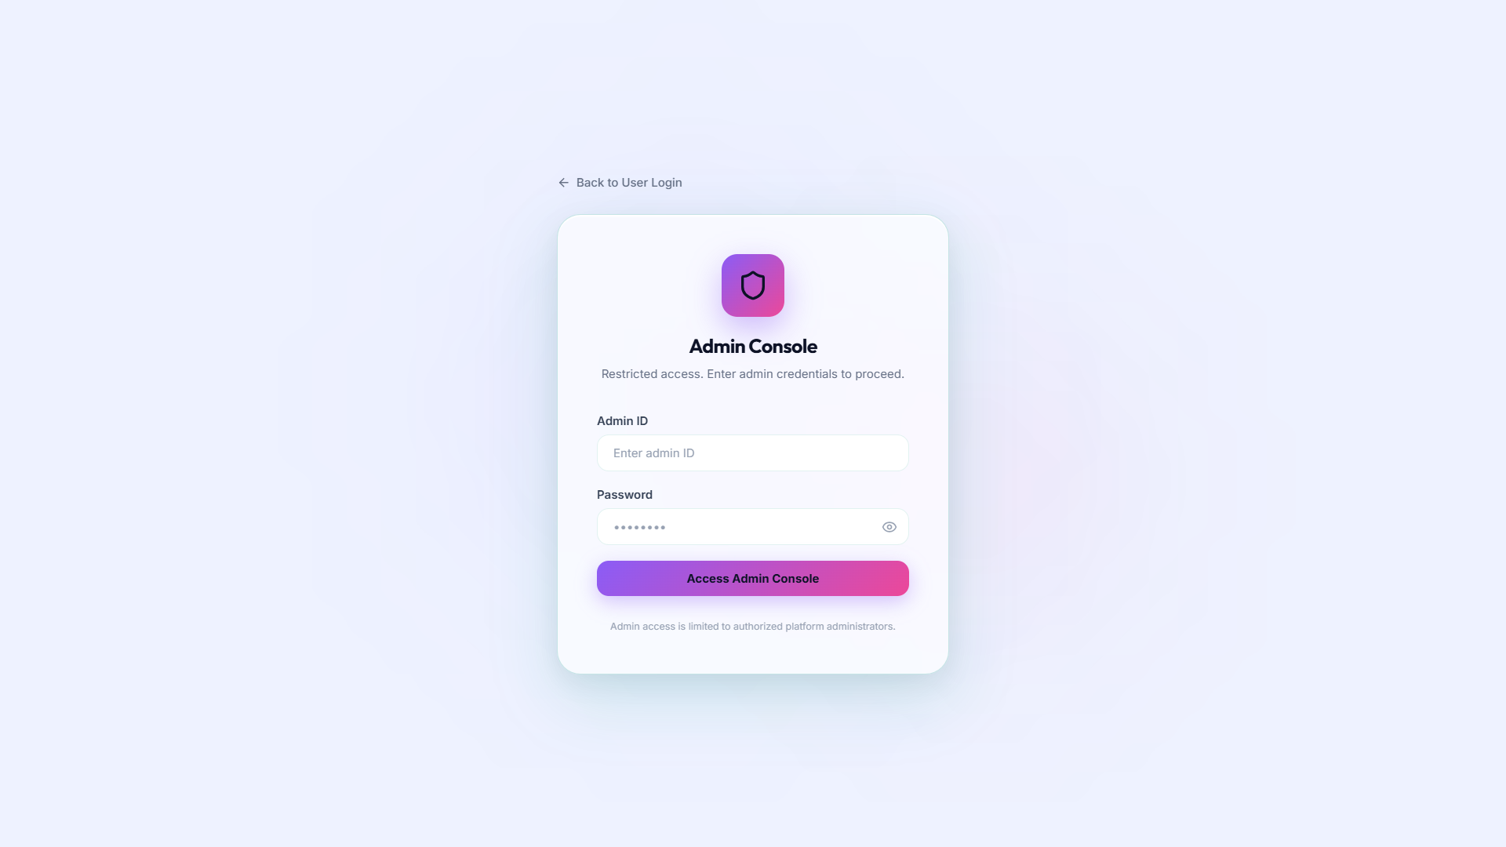
Fig 3.1: Admin Credentials

Slide 56
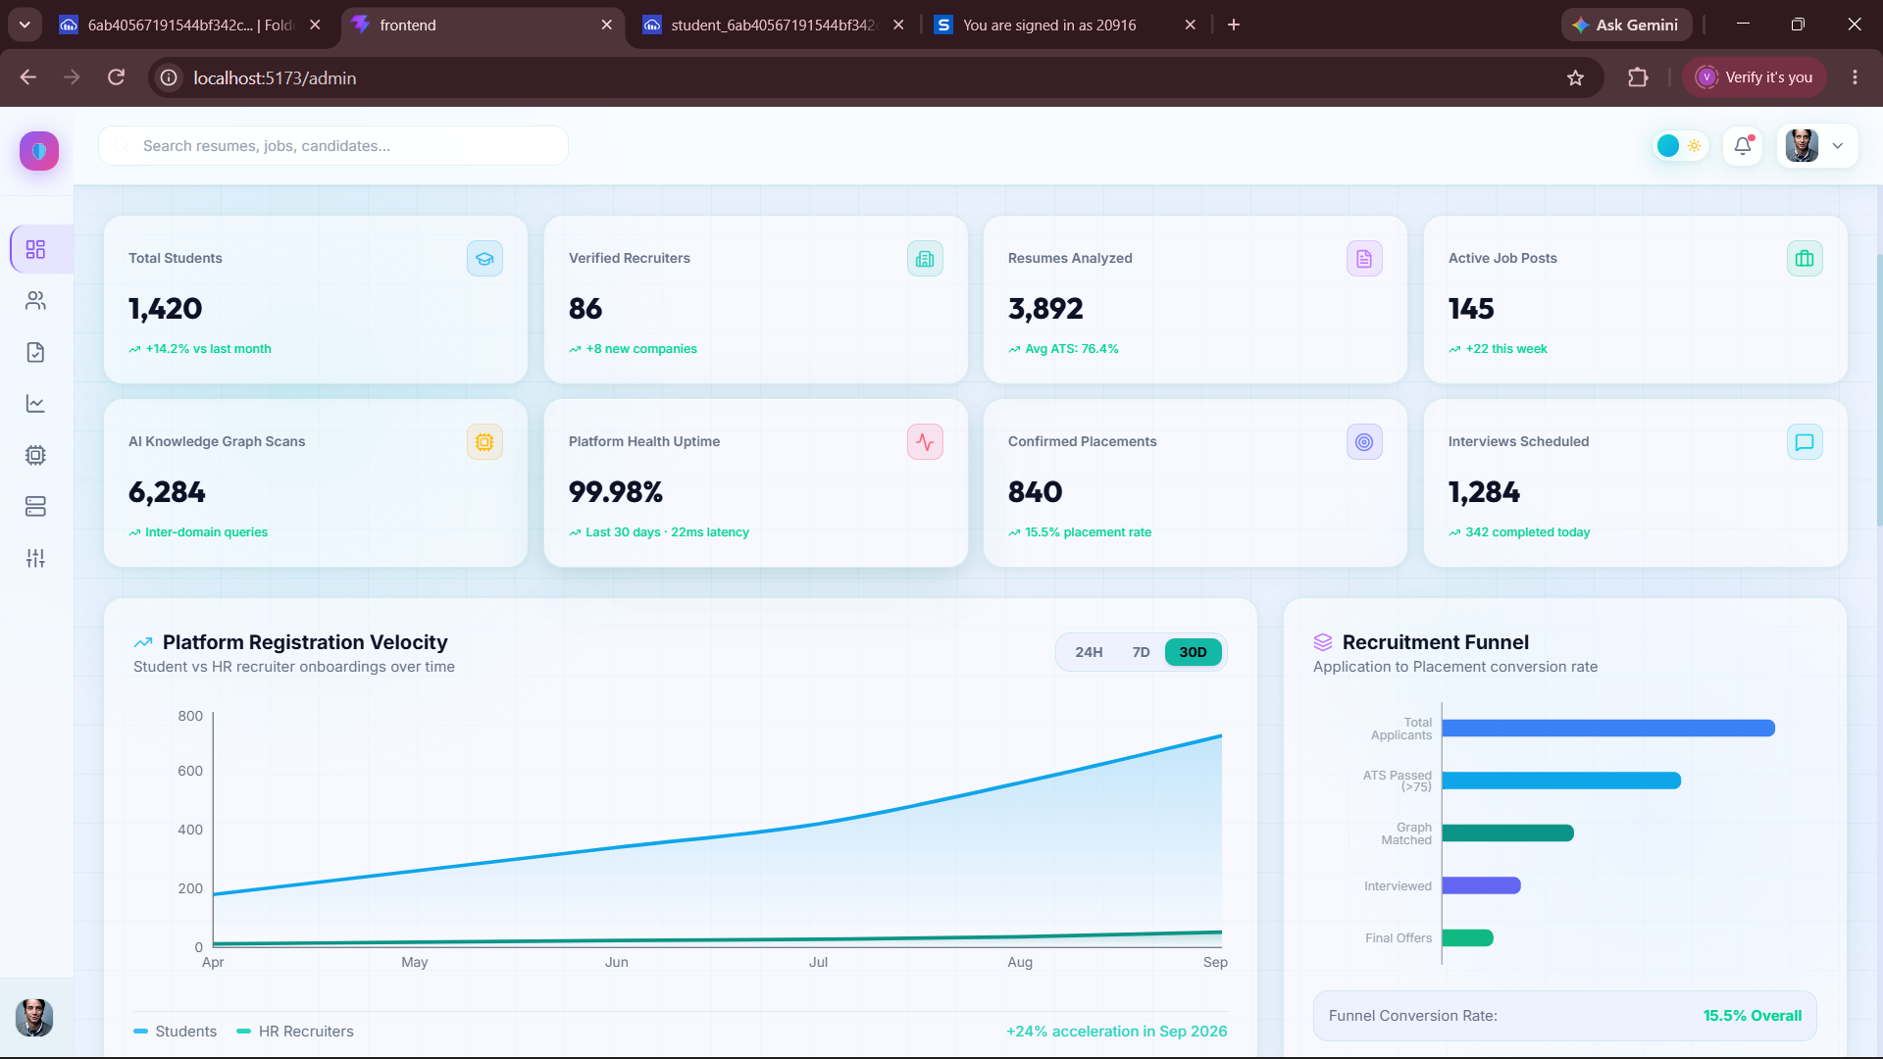
Fig 3.4 : Admin Dashboard

Slide 57
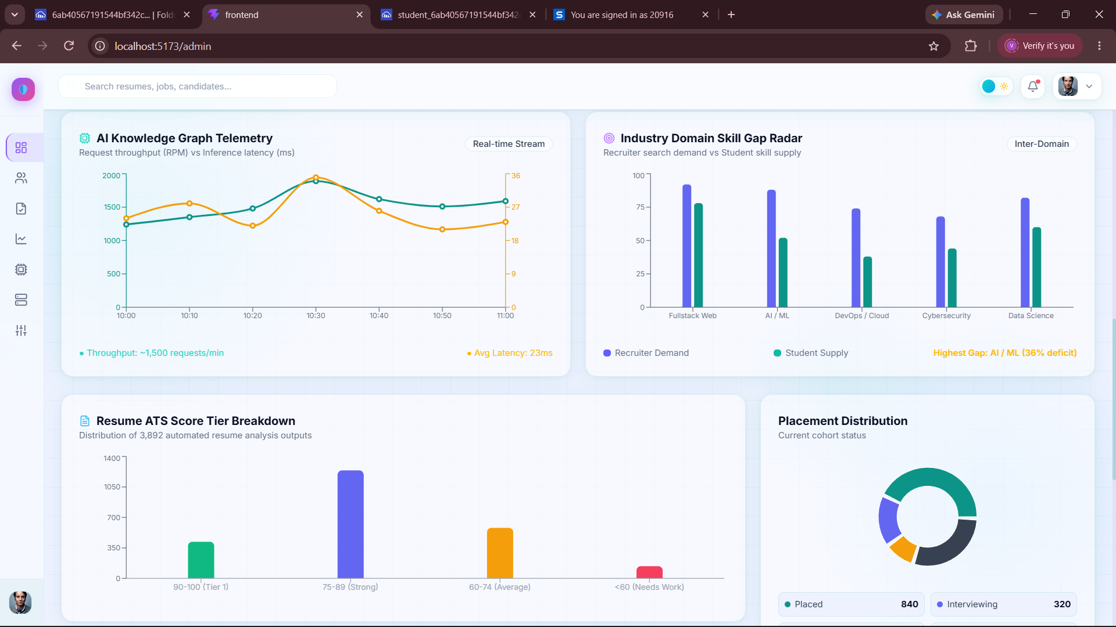
Fig 3.2: User Management page

Slide 58
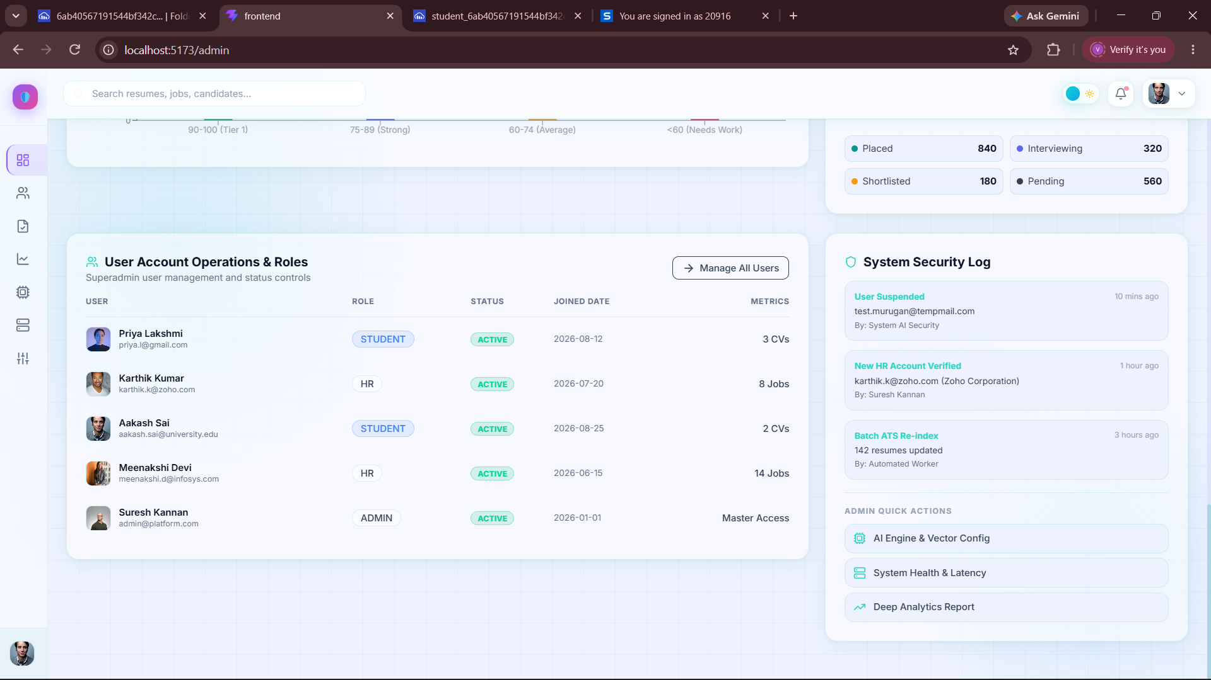
Fig 3.3: Analytics Page

Slide 59

Fig 3.3: Analytics Page

Slide 60

Fig 3.3: Analytics Page

Slide 61

Fig 3.3: Analytics Page

Slide 62

Fig 3.3: Analytics Page

Slide 63

Fig 3.3: Analytics Page

Slide 64

Fig 3.3: Analytics Page

Slide 65

Fig 4.1 : User Collections

Slide 66

Fig 4.2: Parsed Resume Collection

Slide 67
LINK
Github Link : Frontend
Backend
Website Link : LINK

Slide 68
REFERENCES
Sentence Transformers: Semantic Textual Similarity
https://www.sbert.net/
spaCy: Industrial-Strength NLP
https://spacy.io/
ChromaDB: Vector Database for AI Applications
https://www.trychroma.com/
Google Gemini API Documentation
https://ai.google.dev/
Retrieval-Augmented Generation (RAG) for LLMs
https://www.promptingguide.ai/techniques/rag
Resume Parsing with Machine Learning
https://github.com/pyresparser/resume-parser
FastAPI: Modern Python Web Framework
https://fastapi.tiangolo.com/

Slide 69
Thank You

